Slide 1
A Systematic Review of:
Post-Closure Climate Adaptation in the Canadian Mining Sector
Presented by: Trennon Wint
RPD*6250: Foundations in Planning Practice
November 18th, 2024
Notes:
Good morning everyone, my name is Trennon. My research focuses on the role of climate adaptation in the natural resource sector, with a specific interest in the planning process involved in the post-closure phase of mining in Canada.
Today, I’ll be presenting the preliminary work from the first phase of my research, which explores the results of a systematic literature review I conducted related to the state of post-closure climate adaptation in the Canadian mining sector.

Slide 2
Project Introduction
Background Context
Mining is a large industry, and it is getting bigger with the explosion of critical minerals.
Mines are inherently temporary, yet the post-closure phase is historically overlooked.
Climate Adaptation and Post-Closure Planning
Closed mines often leave behind liabilities whose potential to cause harm may be influenced by environmental conditions.
Lack of attention to post-closure planning has raised concerns for local environments and communities in the face of long-term climate change.
WHAT IS THE LINK TO RURALITY?
Notes:
[TRANSITION]. Mining is a major component of the global economy, and will continue to represent a prominent industry as we pursue the vision of a net-zero future. With over 200 active mines, and 6500+ quarries, Canada is the 8th greatest mineral producer on the global scale, and produces upwards of 525 million tons of minerals each year. However, due to the non-renewable nature of mineral resources, all mines must eventually cease production, and in places like Ontario more than 9 in every 10 sites where mining has occurred have already closed [TRANSITION].
Despite this fact, the post-closure phase of mining is historically overlooked. This is problematic because even after rehabilitation, closed mines often leave behind liabilities whose potential to cause harm can be influenced by environmental conditions. In the face of climate change, this has raised concerns about the threats post-closure sites may pose to local environments and communities in the generations to come [TRANSITION].
This is a uniquely rural issue. In Canada, the majority of mining operations are based in rural and northern communities. That means that any impacts which do manifest from this issue, are disproportionately impacting these demographics.

Slide 3
Problem Statement & Goals
Where Does This Research Fit?
Goal: Further our understanding of the role that climate change resiliency practices should play in the long-range planning for post-closure mine sites in Canada.
Objectives
Characterize the current state of knowledge and action surrounding climate resiliency in the post-closure phase of Canadian mining operations.
Develop a plan evaluation framework to assess the resiliency of long-term management plans for post-closure mine sites in Canada to the impacts of climate change.
Apply the developed plan evaluation framework to evaluate the climate resiliency of existing long-term management plans for Canadian post-closure mining sites.
(1)
(2)
(3)
Notes:
Because the post-closure phase is often overlooked, there is a large gap in our understanding about how hazards left behind by mines impact the social, economic, environmental, and human health conditions of communities and environments in the years following closure [TRANSITION]. Now, as a whole, the goal of my research is to further our understanding of the role that climate resiliency should play in the long-range planning for post-closure mine sites in Canada. [TRANSITION]
However, as shown on the screen, there are several objectives which need to be met to fulfill this goal. The research I’m presenting to you today works towards satisfying the first, which is to characterize the current state of knowledge and action on climate resiliency in the industry.

Slide 4
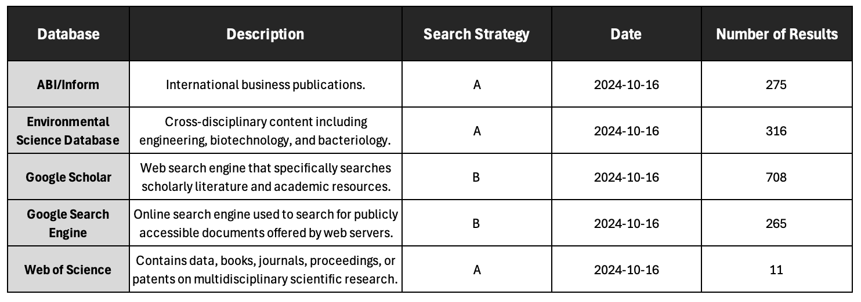
Methods: Search Strategy
Search Strategy A: title(("mine" OR "mines" OR "mining" OR "mineral extraction")) AND ("clos*" OR "long term" OR "perpetual" OR "rehabilit*" OR "reclam*" OR "restor*") AND ("climate chang*" OR "global warming" OR "extreme weather") AND ("resilien*" OR "adapt*") AND ("Canada" OR "British Columbia" OR "Alberta" OR "Saskatchewan" OR "Manitoba" OR "Ontario" OR "Quebec" OR "Newfoundland" OR "Nova Scotia" OR "New Brunswick" OR "Prince Edward Island" OR "Nunavut" OR "Yukon" OR "Northwest Territories")
Search Strategy B: ("mining") ("closure") ("climate change") (adaptation OR resilience) (Canada)
Notes:
In order to satisfy that first objective, I undertook a systematic literature review of both scholarly and grey-literature to better understand who is talking about climate adaptation in this phase of the mining industry, and what themes were emerging from these conversations [TRANSITION].
For sake of time, I won’t dive too deep into the methods but, I’m more than happy to revisit this during the Q&A. What I’m showing you now is a glimpse into how the search was conducted, including the relevant databases and search terms used. The initial search returned over 1500 publications but, after applying a practical screening (for instance, eliminating publications which were not in English, or did not talk about Canada), I was only left with 155 relevant results.

Slide 5
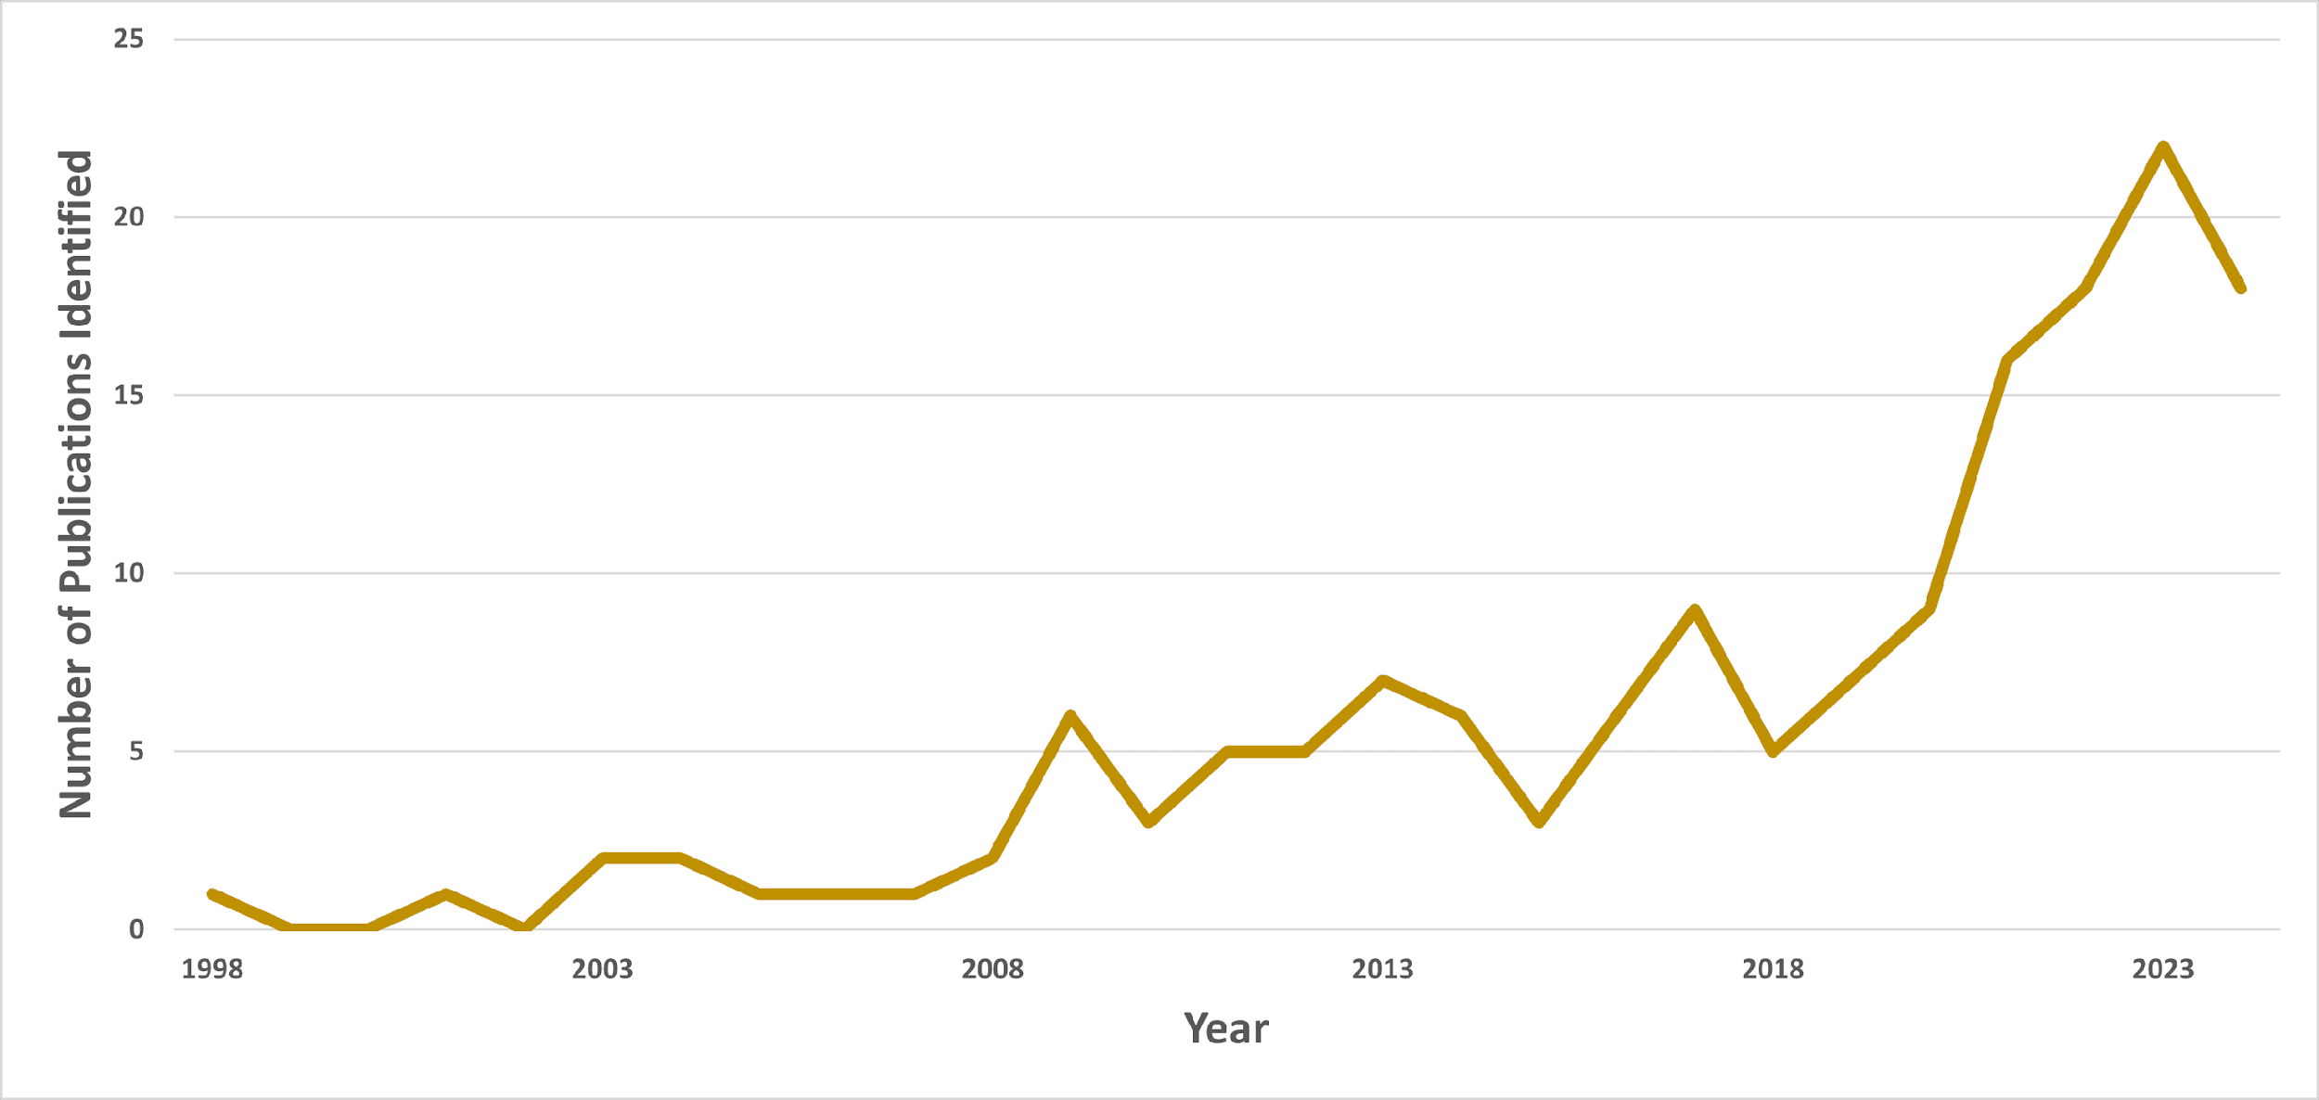
Methods: Refining Results
The 155 results (below) were randomly sampled to include 5 per year for the last decade (n = 53).
Notes:
[TRANSITION]. Now unfortunately, analyzing 155 publications was a bit beyond my capacity for this semester, so instead I randomly sampled 5 publications from each year since 2014. In some cases, like 2014 and 2015, there were less than 5 publications available, in which case I just reviewed them all from that year. This left me with a total of 53 publications.

Slide 6
Methods: Literature Analysis
A total of 40 variables were collected for each publication, corresponding to the following categories:
Publication Information
Climate Content
Application
Publication Type
Affiliations
Location and Scope
Publication Purpose
Challenges
Actions Taken
Recommendations
Available Resources
Climate Events Discussed
Climate Data Outlook
“Importance Score”
Importance Score: The number of times a synonym for a concept of interest (e.g., “climate change”) is used per every 10,000 words in the document.
Examples: Climate Change, Extreme Weather, Global Warming, etc.
Notes:
[TRANSITION]. In terms of analysis, I extracted 40 variables from each publication which broadly fall into one of three categories [TRANSITION]:
Information About the Publication Itself
Information About How Climate Change is Discussed
Information About How Climate Change Adaptation or Long-Range Planning are Conducted
[TRANSITION]. Under the climate content heading you’ll see “Importance Score”. This was an indicator I used to determine how important various concepts were within each publication. Mainly I wanted to compare how publications prioritized discussions on climate, resilience, mitigation, and mine closure. To do this, I divided the number of times that a concept was mentioned by the word count of the document, and then multiplied that by 10,000. So anytime you see “Importance Score”, you can just think “mentions per every 10,000 words”.

Slide 7
Results: Publication Information
Publication Source:
47% Journal Articles
22% Private Reports
17% Theses
11% Industry Newsletters
2% Book Chapters
Special Mentions to Journal of Environmental Science and Pollution Research
Published 12% of All Relevant Journal Articles
Author Affiliations:
55% Academic Institutions
28% Private Sector
15% Government
2% NGOs
Notes:
[TRANSITION]. When I analyzed my data, I found that close to 70% of publications originated from either private reports or journal articles [TRANSITION].
In terms of authorship, the majority of authors came from academic institutions, with some notably low representation from governments.

Slide 8
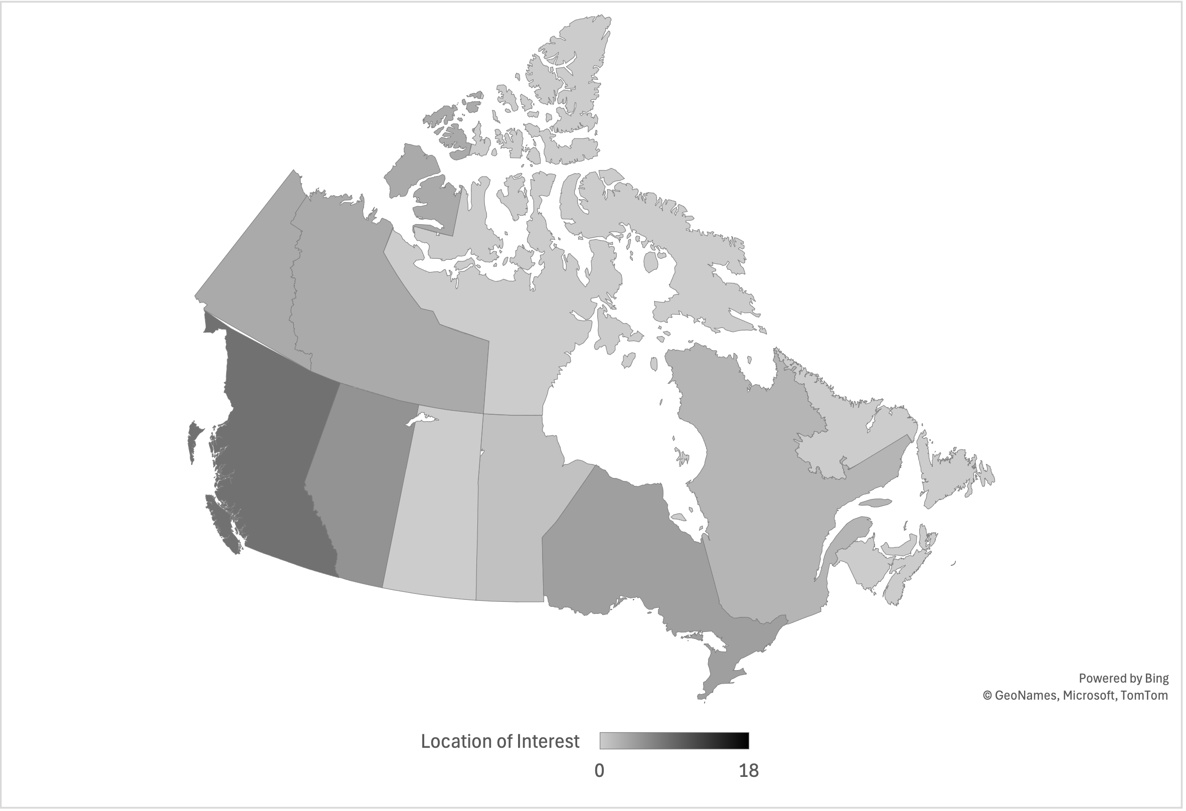
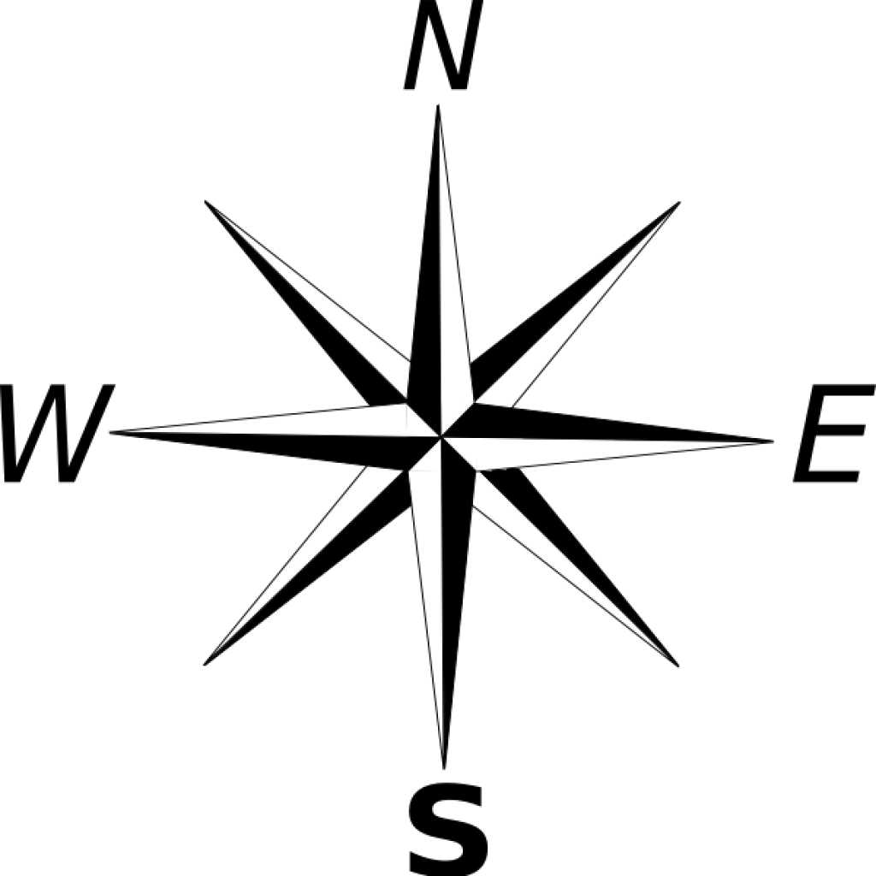
Results: Publication Information
In which provinces were studies most focused?
55%
20%
Canadian Mines Based in B.C & O.N
Canadian Mines
Based in Territories
Notes:
The locations most frequently discussed in publications were British Columbia, Alberta, Ontario, Quebec, as well as some of the Northern Territories [TRANSITION]. This makes a lot of sense, as most Canadian mines are based in B.C and Ontario, while the Territories account for another 20%.

Slide 9
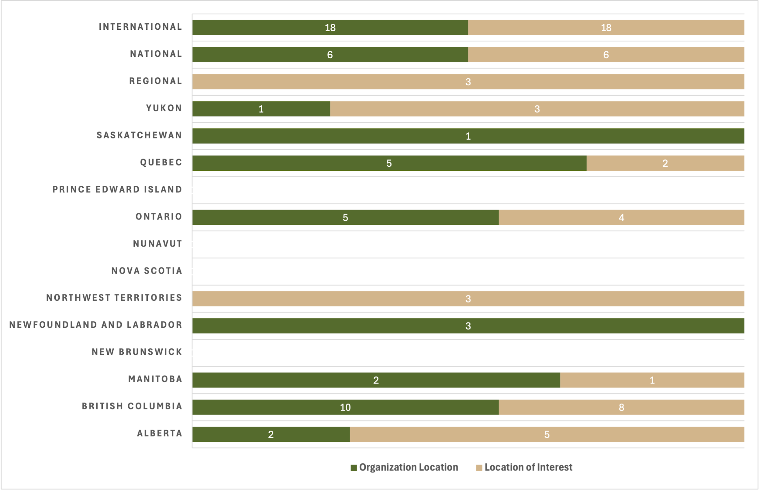
Notes:
What’s interesting is when we compare the last graphic with this figure, which shows the proportion of publications which originated from a given location, compared to the number which were interested in that location.
As you can see, certain regions like PEI or Nova Scotia, had no representation. In Quebec, we had many publications originating from this province but, relatively few which focused on the local context. Whereas the reverse is true in Alberta.

Slide 10
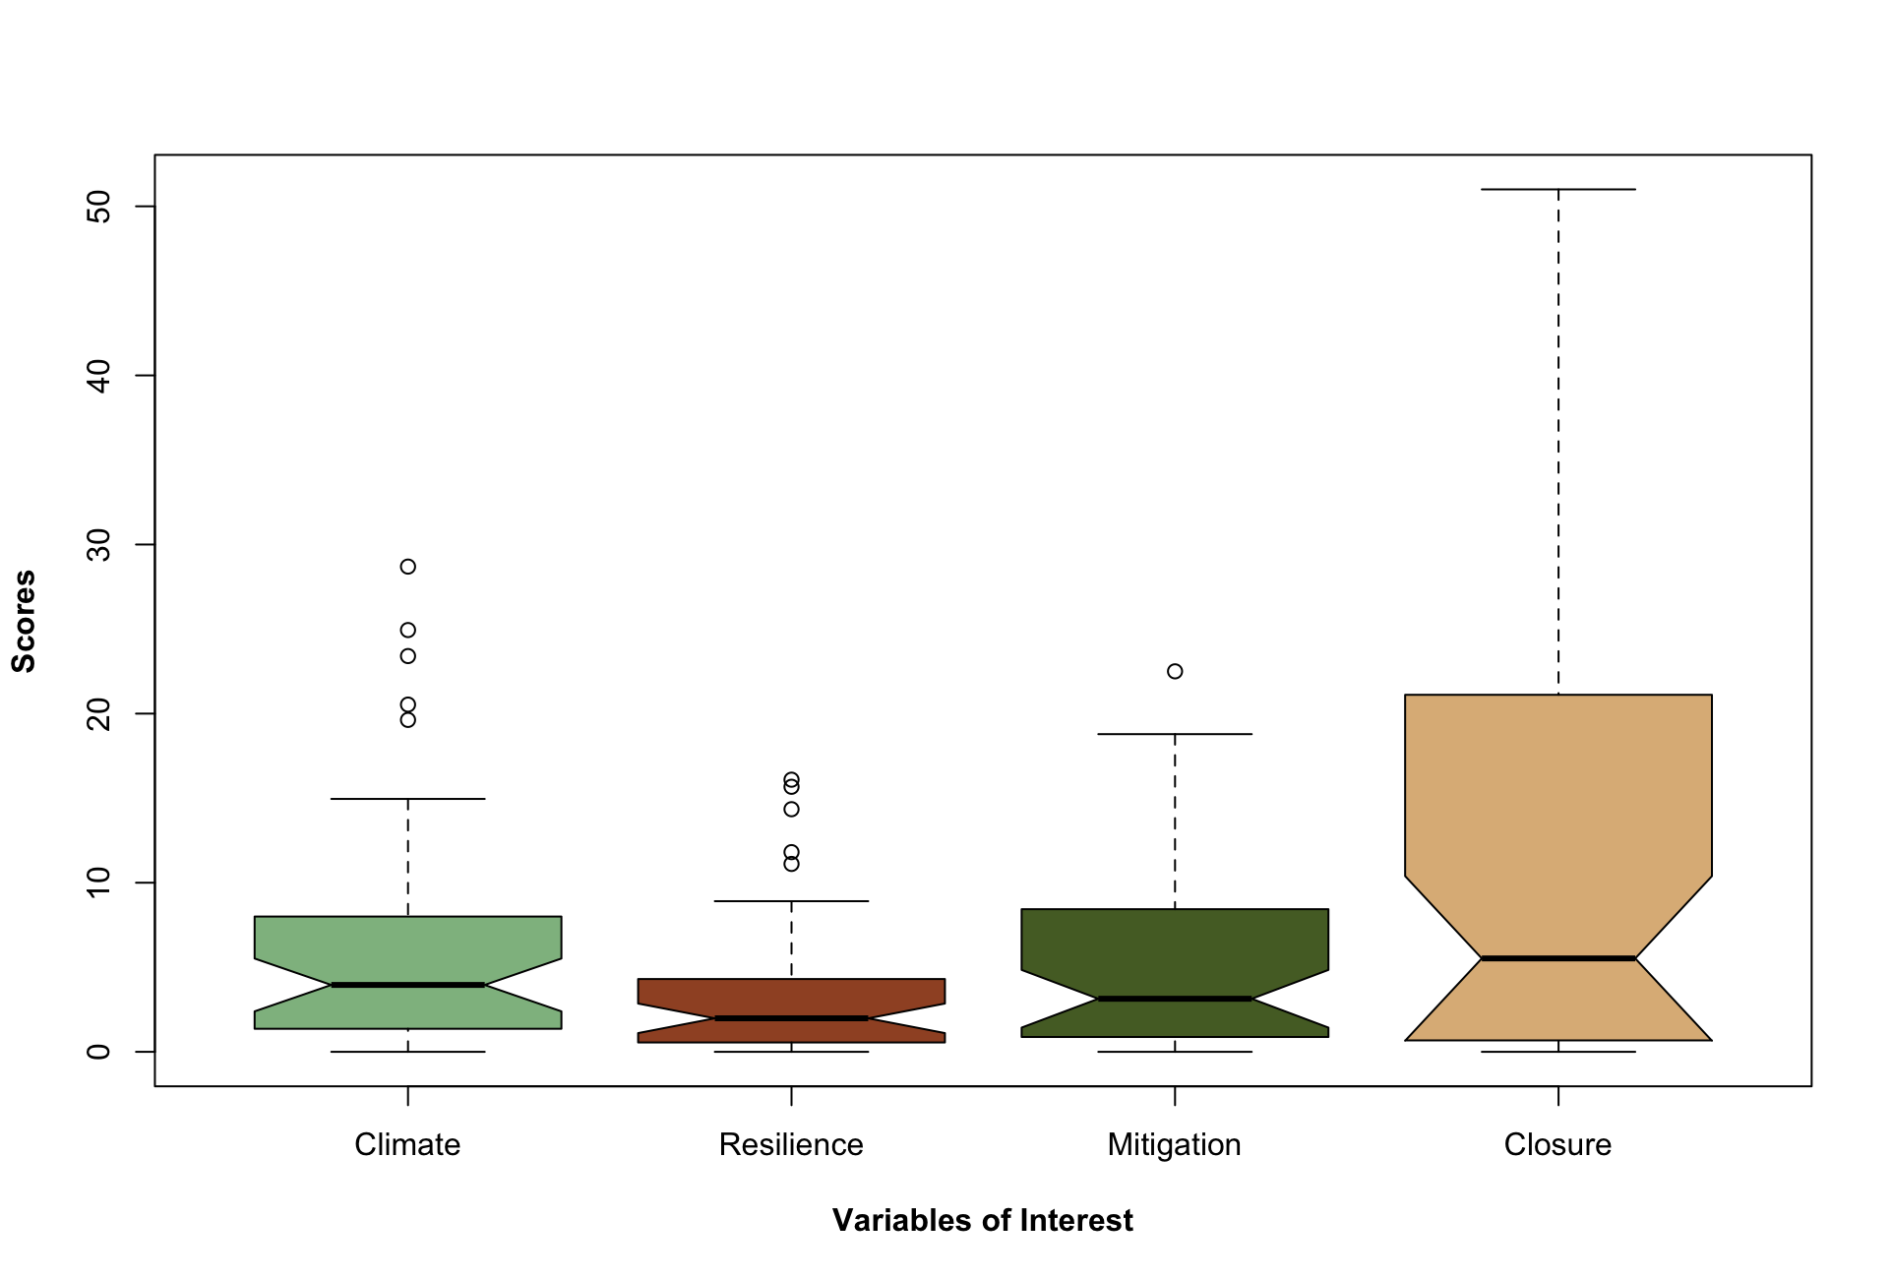
Results: Climate Content
How important are the following concepts?
Notes:
Now earlier I introduced the idea of “Importance Scores”. The figure behind me is showing the ranges of Importance Scores for all publications in terms of their focus on Climate, Resilience, Mitigation, and Mine Closure. While the ranges do vary, the average values (indicated by the black lines) did not differ from one another in a statistically significant manner.

Slide 11
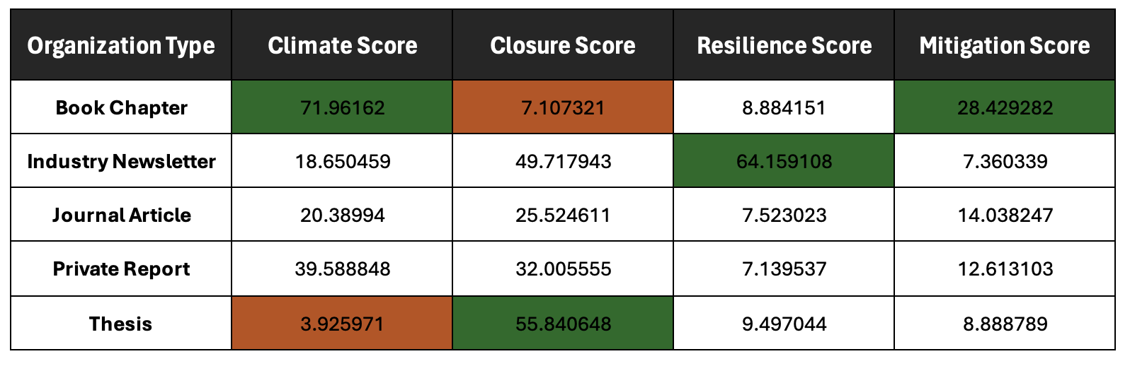
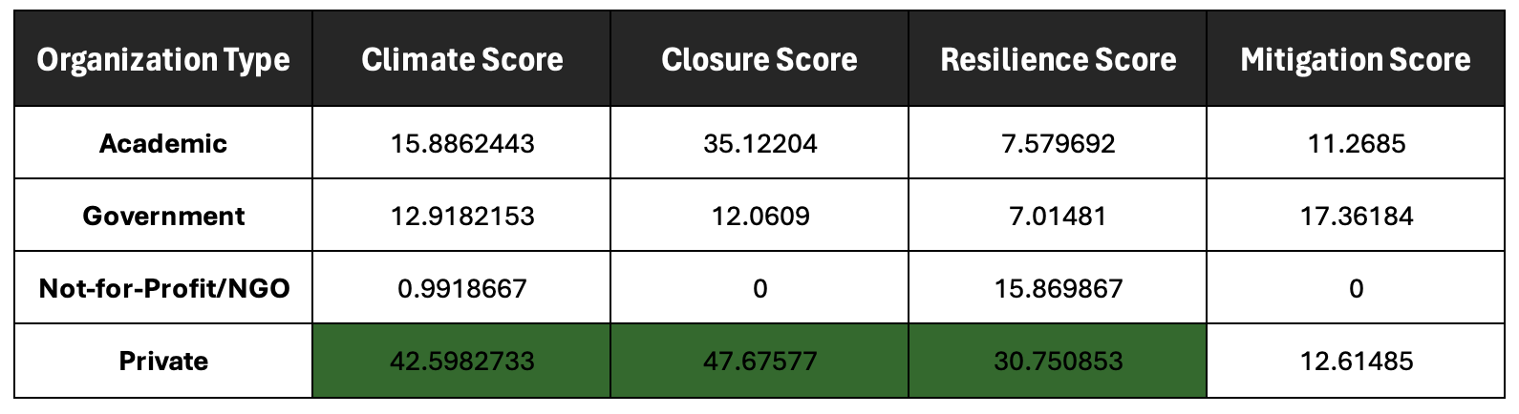
Source Type
Notes:
When you break the average Importance Scores down by source type, or organization type, we do start to see some interesting things emerge. For instance, the private sector consistently scored higher in Climate, Resilience, and Mine Closure Importance Scores.

Slide 12
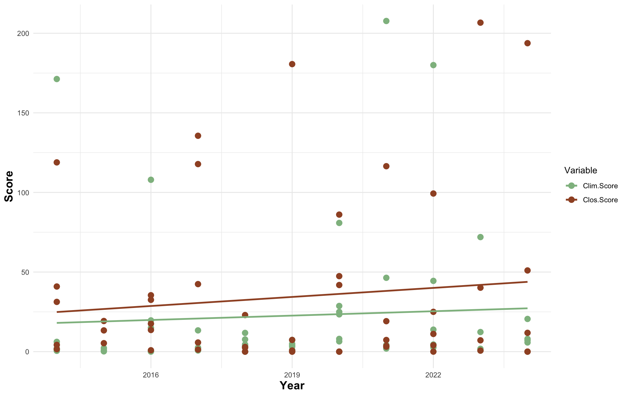
Results: Climate Content
How has dialogue changed over time?
p = 0.4267
p = 0.6585
Notes:
If we look at how Importance Scores for Climate and Mine Closure have changed over time, we see that there is this really faint increase since 2014 however, this was not statistically significant. Therefore we can conclude that although the quantity of publications discussing these concepts has increased substantially in the last decade, the actual quality of this conversation may not have changed much.

Slide 13
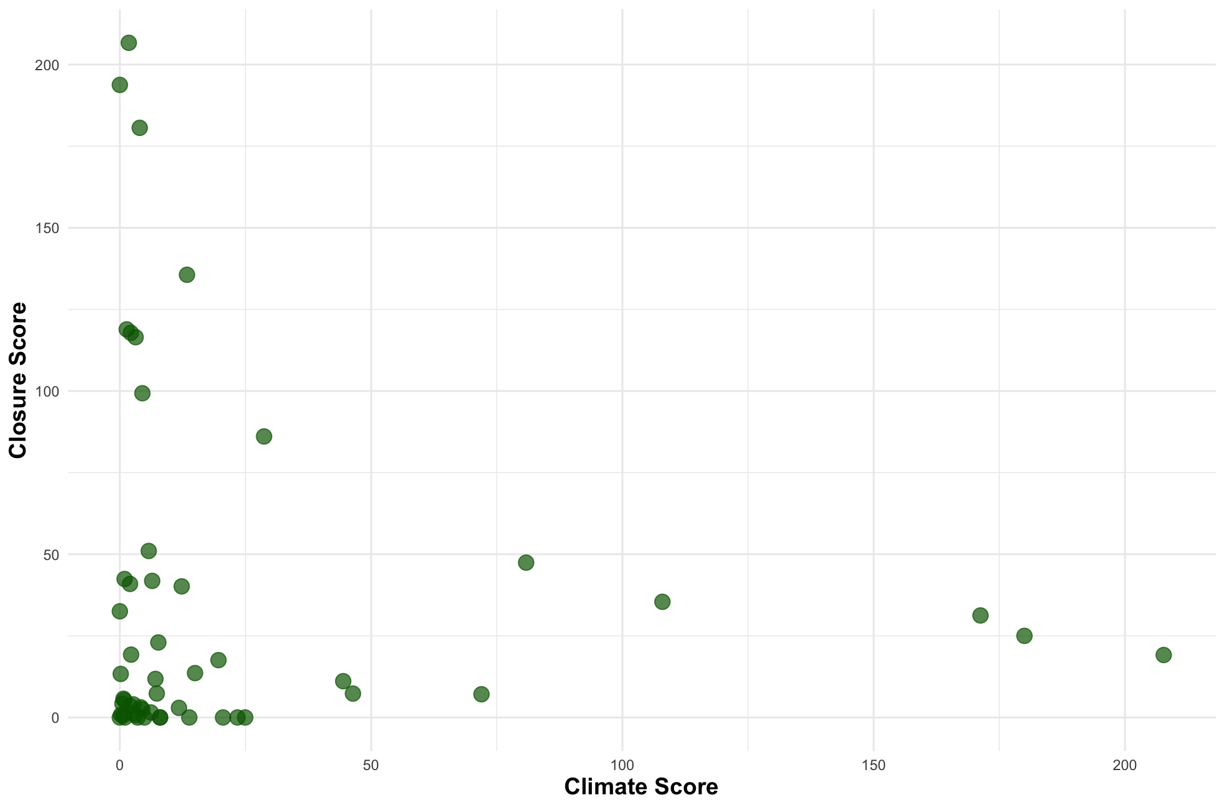
Results: Climate Content
Are we having the right discussion?
Notes:
One of the things that backs up that argument, is this figure right here, where each publication appears as a green dot on the graph, and their Importance Scores for Climate and Mine Closure dictate their placement.
We have a lot of publications which [TRANSITION] score low in their focus on both concepts, some [TRANSITION] which score high in one and low in the other, but notably [TRANSITION] there is a complete absence of publications which score high in both.

Slide 14
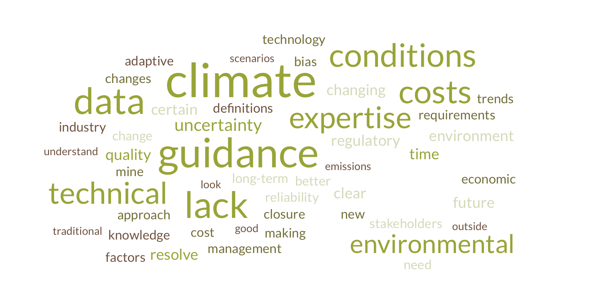
Results: Application
What are the key challenges?
How has dialogue changed over time?
6%
19%
20%
Described an
Action Taken
Identified
Resources
Reported on
Climate Outlooks
Notes:
The last thing I want to talk about is some of the barriers to implementing climate adaptation practices. This word-cloud shows the relative frequency at which certain terms were used in the quotes I pulled from each publication discussing these barriers.
Overwhelmingly, we see concepts like: “lack of guidance”, “high costs”, “data quality”, and “lack of expertise” being mentioned [TRANSITION]. These barriers are evident in the data I collected, as we see that fewer than 6% of publications actually described an action they took related to climate adaptation and mine closure, while only about 20% were able to identify a relevant resource, or report on the climate data they used.

Slide 15
Discussion and Future Work
What We Found:
Conversation quantity is increasing, but the quality might not be.
The academic community is far ahead of the private sector and governments.
  However, the private sector is producing more publications directly related to the issue.
Climate adaptation practices are impeded by a lack of guidance, knowledge, and funding.
Limitations:
Access to publications limited to University of Guelph subscriptions or open-access documents.
Adjustments needed for search terms.
Future Work:
Interviews with mining, climate, and policy professionals.
Development of a plan evaluation framework.
Notes:
[TRANSITION]. To summarize, this work found an increasing number of publications talking about mine closure and climate adaptation but, the quality of these discussions has not significantly changed in the last 10-years. We see that academics are ahead of both the private sector and governments, however the private sector is producing more publications which are directly relevant. And lastly, climate adaptation practices may be falling behind in the industry due to a lack of guidance, knowledge, and funding [TRANSITION].
This research is not without its limitations, dominantly related to the search strategy, which I am happy to get into further during the Q&A [TRANSITION].
But I’d like to end the presentation by stating that soon, we’ll be conducting interviews with professionals to better understand how we can make post-closure plans climate-ready. We hope to use this information to create a plan evaluation framework that will provide some of that guidance to the industry, which it is currently lacking.

Slide 16
Thank You
Are there any questions?
wintt@uoguelph.ca
www.linkedin.com/in/trennon-wint
Notes:
And with that, I’d like to thank you all for your time this morning and open up the floor to any questions.

