Slide 1


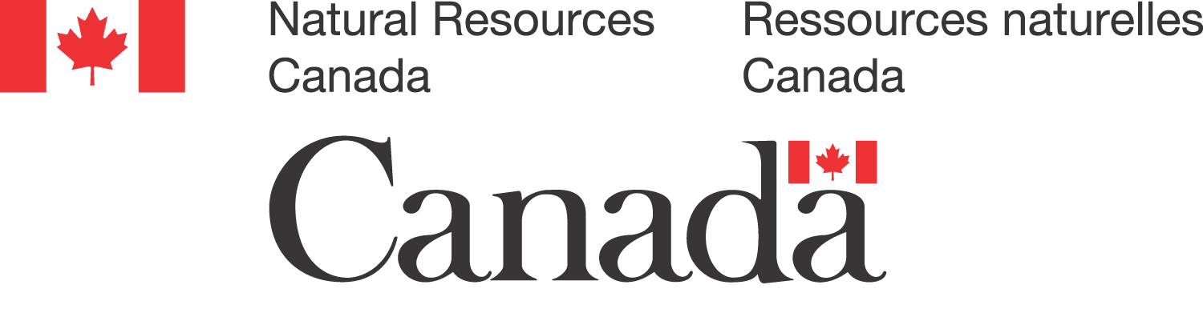
Climate Ready Mine Project
Project Overview
Sept 22-24, 2025
Presented by: University of Guelph, RFS Energy
Supported by: Giant Mine Oversight Board
Notes:
Speaker: Laura
As you may know, our team - which includes RFS Energy and the University of Guelph with in-kind support from GMOB - set out to explore how emerging climate change risk assessment frameworks can be used to integrate climate resilience strategies to mine closure planning, using Giant Mine as a real-world case study.
It is our hope that the findings and outputs of our project will be beneficial and complimentary to existing efforts to incorporate a climate change lens into mine closure and post closure - including the Giant Mine Remediation Project. With this in mind, we are excited to be meeting with you today and keen to hear more about these efforts directly from the Project Team.
We’ve kept our presentation brief to give a broad overview of our project as a starting point. We are hoping that this conversation will be the first of many. After we share some background information about our project, we have reserved most of the meeting time for discussion and Q&A and welcome any thoughts one how this project might support existing efforts.
The project is supported by NRCan through the Climate Change Adaptation Program that aims to support decision-makers in identifying and implementing adaptation actions, enhance adaptation knowledge and skills among Canada’s workforce and increase access to climate change adaptation tools and resources.

Slide 2
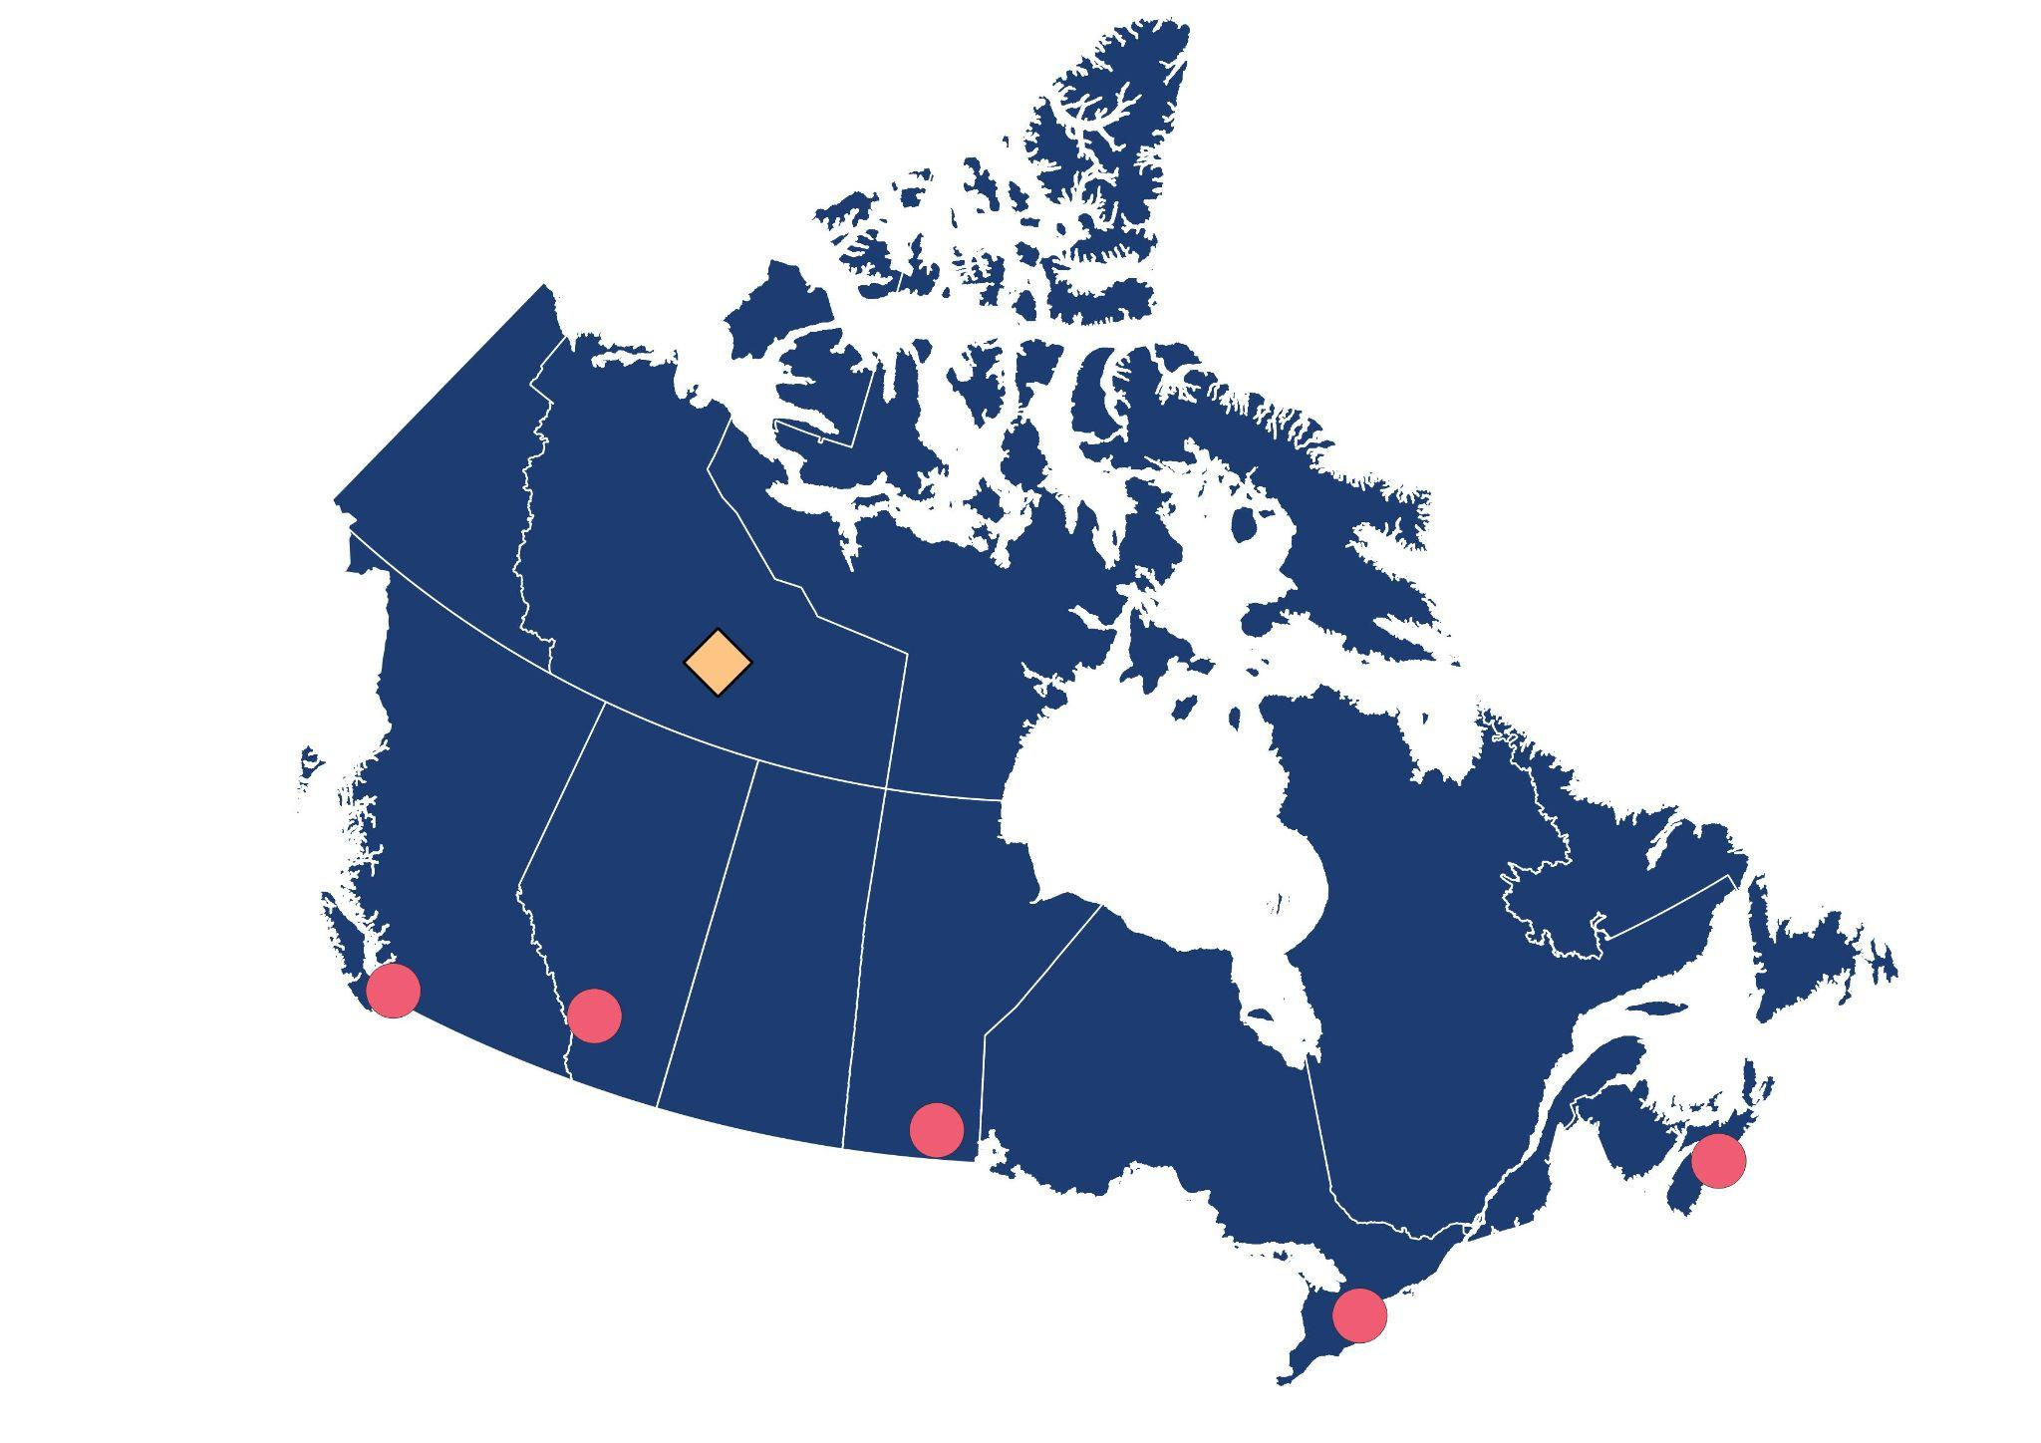
Land Acknowledgement
We recognize that we’re joining today from many places across Turtle Island. Some of us are based in Toronto, on the traditional territory of the Mississaugas of the Credit, Anishnabeg, Chippewa, Haudenosaunee, and Wendat peoples and Vancouver, the unceded territories of the Musqueam, Squamish & Tsleil-Waututh nations.
Our work also uses Giant Mine as a real world example, located on Chief Drygeese Territory, home of the Yellowknives Dene First Nation and within the boundaries of North Slave Metis Alliance. We’re grateful to do this work in partnership with communities and in the spirit of respect and learning.
Notes:
Speaker: Laura
Although we are meeting virtually from many regions across what is now called Canada, we want to take a moment to reflect on the the lands that each of us occupy today, and to recognize Indigenous Peoples who have stewarded these lands, waters, and skies since time immemorial.
I am speaking to you today as a guest on the Treaty Lands and traditional territory of the Mississaugas of the Credit First Nation, also known as Oakville, Ontario. This region has been cared for by many Nations - the Haudenosaunee, the Huron Wendat and the Neutral Peoples - and they continue to hold deep cultural and spiritual significance today.
As you know, our project is largely focused on the Giant Mine site in the Northwest Territories, within the traditional territory of the Yellowknives Dene First Nation and the larger homelands of the Dene Peoples. We recognize that this region is also deeply meaningful to the Métis and Inuit communities, who continue to maintain relationships with these lands.
Our team works from coast to coast, and this project is grounded in a commitment to environmental stewardship and meaningful community engagement. We acknowledge that true sustainability cannot be achieved without listening to, learning from, and working in partnership with Indigenous communities who have long protected and understood these environments.
We express our respect and gratitude to the Indigenous Peoples past and present who care for these territories, and we commit to carrying out this work in a way that honours those responsibilities.

Slide 3
Climate Ready Mine Project
The Climate Ready Mine Project is a collaboration between the University of Guelph, RFS Energy and with the support from the Giant Mine Oversight Board to understand how components of mine closure plans can be assessed for their adaptive capacity and resilience to the long-term impacts of climate change.
This project is funded by Natural Resources Canada’s Climate Change Adaptation Program.
Notes:
Speaker: how do you do the thing and how you have done a good enough job that climate change lens is properly incorporated - it is the process. how do you help a group like GMOB who is working with remediation team - yes i feel confident to say they have done a good job integrating climate change lens - and here is why. How do you get to that confidence? It took us a year and half to find a climate modeller - we are excited to talk to this group who also probably finding trouble to fill in those gaps.
*DO NOT MENTION: how do you make something accessible but tailor to be specific/local context- the opportunities and challenges of create this tool/and how could it fail?
The Climate Ready Mine Project is a collaboration between the University of Guelph, RFS Energy and the Giant Mine Oversight Board exploring how emerging climate change risk assessment frameworks can be used to integrate climate resilience strategies to mine closure planning, using Giant Mine as a real-world case study.
This project is funded by Natural Resources Canada’s Climate Change Adaptation Program that was publicly announced last month. The program that supports Canada’s regions and sectors to adapt to a changing climate and aims to:
support decision-makers in identifying and implementing adaptation actions;
enhance adaptation knowledge and skills among Canada’s workforce; and
increase access to climate change adaptation tools and resources.
Our project was one of 7 funded in the North. We intend to reach out to both NWT-based teams who were also awarded funding for related projects to see where there might be opportunities for collaboration and/or shared learnings and resources.
GNWT will be looking to increase workforce capacity in NWT related to climate impacts through adaptation training & educational resources.
Sahtu Renewable Resources Board will be looking into Integrating Climate Change Resilience into Site Closure and Reclamation through research into drilling sumps, contaminant mobility and the impacts of current and future climate change.
GNWT Project:
This project will increase the workforce capacity of the Northwest Territories (NWT) to plan for and respond to climate impacts by increasing its access to adaptation training resources and educational materials tailored to the northern context and including an Indigenous perspective. The project will develop and deliver a series of webinars and courses targeting various audiences including NWT professionals and practitioners, Indigenous governments and organizations, local/community governments and elected officials.
Sahtú Renewable Resources Board:
This project will evaluate existing research on drilling sumps to identify and define the risks associated with the mobility of contaminants. The project will include the development of land reclamation guidance aimed at re-establishing safe conditions for land use by the Sahtú Dene and Métis communities, taking into account the impacts of current and future climate change.
announced in March
Develop a Summary Report and Presentation outlining the process taken to assess climate risk and adaptation strategies using GMRP as a case study; and use it to replicate for other climate risk sites across Canada.
Use the Giant Mine Remediation Project in the Northwest Territories as a case study to document the benefits of integrating climate change adaptation lens in mine closure planning.
Identify opportunities for additional tools & resources tailored to varying audiences, this may include capacity building and job shadowing opportunities.
Share an assessment tool with the advisory committee and convene a meeting/presentation series to local partners to assess post-closure and perpetuity plans for ‘climate readiness’.
Intention is to provide meaningful adaptation strategies that can feasibly be implemented by remediation teams across the North over short, medium and long timeframes based on risks identified.

Slide 4
Project Partners & Team
Laura Gareau Sanchez (COO & Co-Founder)
Aarisha Haider (Project Manager)
Sarah-Anne Thompson
(Research & Engagement Lead)
Dr. Nicolas Brunet (Associate Professor - Rural Planning & Development)
Graduate Researchers
Notes:
Speaker: Laura
This project represented a collaboration between academia (University of Guelph), industry (RFS Energy) and the non-profit sector (GMOB). These three organizations worked collaboratively to design & launch the project, each with its own distinct role in the project:
We wanted to take a moment to share a bit more about the multidisciplinary team behind the project.
Dr. Nicolas Brunet and his research team at the University of Guelph is the Principle Investigator and the lead organization and grant recipient. The UofG will play an oversight role for the project, as well as strategic guidance on all research methods and activities. He is supported by a number of undergrad and graduate students, and so this project is also providing valuable hands-on learning opportunities for students in his department.
RFS Energy is a small sustainability consulting firm, with a team of 12 and a strong background in project management, design, market research and implementation in the clean energy and climate sectors as well as extensive experience leading successful federally-funded projects. RFS Energy is a host employer for several internship placements and this project has provided several meaningful and hands-on job opportunities for students and recent grads.
GMOB you of course know. GMOB’s role in this project is to
Act as liaison between and facilitate meetings with the project team, GMOB and the Giant Mine Remediation Project (GMRP) Team
Advise on community engagement approach and knowledge-sharing tactics and channels
Provide local context and subject matter expertise on GMRP
As we move into the second phase of our work, we are looking to increase involvement and participation from local individuals, groups and organizations as appropriate.

Slide 5

Project Overview
What
To further our understanding of how mine closure plans can be assessed for resilience and adaptive capacity to the long-term impacts of climate change.
Visual narratives by Yellowknife artist Alison McCreesh
Notes:
Speaker: Aarisha
Project objective from NRCan CA: Increase climate change adaptation knowledge & capacity among mining professionals, decision-makers, rights-holders

Slide 6
Project Overview
What
To further our understanding of how mine closure plans can be assessed for resilience and adaptive capacity to the long-term impacts of climate change.
How
Research - Assess current state of climate adaptation in post-closure planning and understand existing climate change adaptation mechanisms & supports
Engagement - Gather and integrate insight & feedback from stakeholders, rights holders and other interested parties including Advisory Committee
Knowledge-sharing - Use findings to inform development of a climate readiness assessment tool and share results
Visual narratives by Yellowknife artist Alison McCreesh
Notes:
Speaker: Aarisha
Project objective from NRCan CA: Increase climate change adaptation knowledge & capacity among mining professionals, decision-makers, rights-holders

Slide 7
Project Overview
What
To further our understanding of how mine closure plans can be assessed for resilience and adaptive capacity to the long-term impacts of climate change.
How
Research - Assess current state of climate adaptation in post-closure planning and understand existing climate change adaptation mechanisms & supports
Engagement - Gather and integrate insight & feedback from stakeholders, rights holders and other interested parties including Advisory Committee
Knowledge-sharing - Use findings to inform development of a climate readiness assessment tool and share results
Why
Support & build on existing efforts to incorporate a climate lens into mine closure plans and protect human and environmental health
New frameworks are emerging to integrate climate change into mine closure plans - however resources are limited and/or not well understood
Visual narratives by Yellowknife artist Alison McCreesh
Notes:
Speaker: Aarisha
Project objective from NRCan CA: Increase climate change adaptation knowledge & capacity among mining professionals, decision-makers, rights-holders

Slide 8
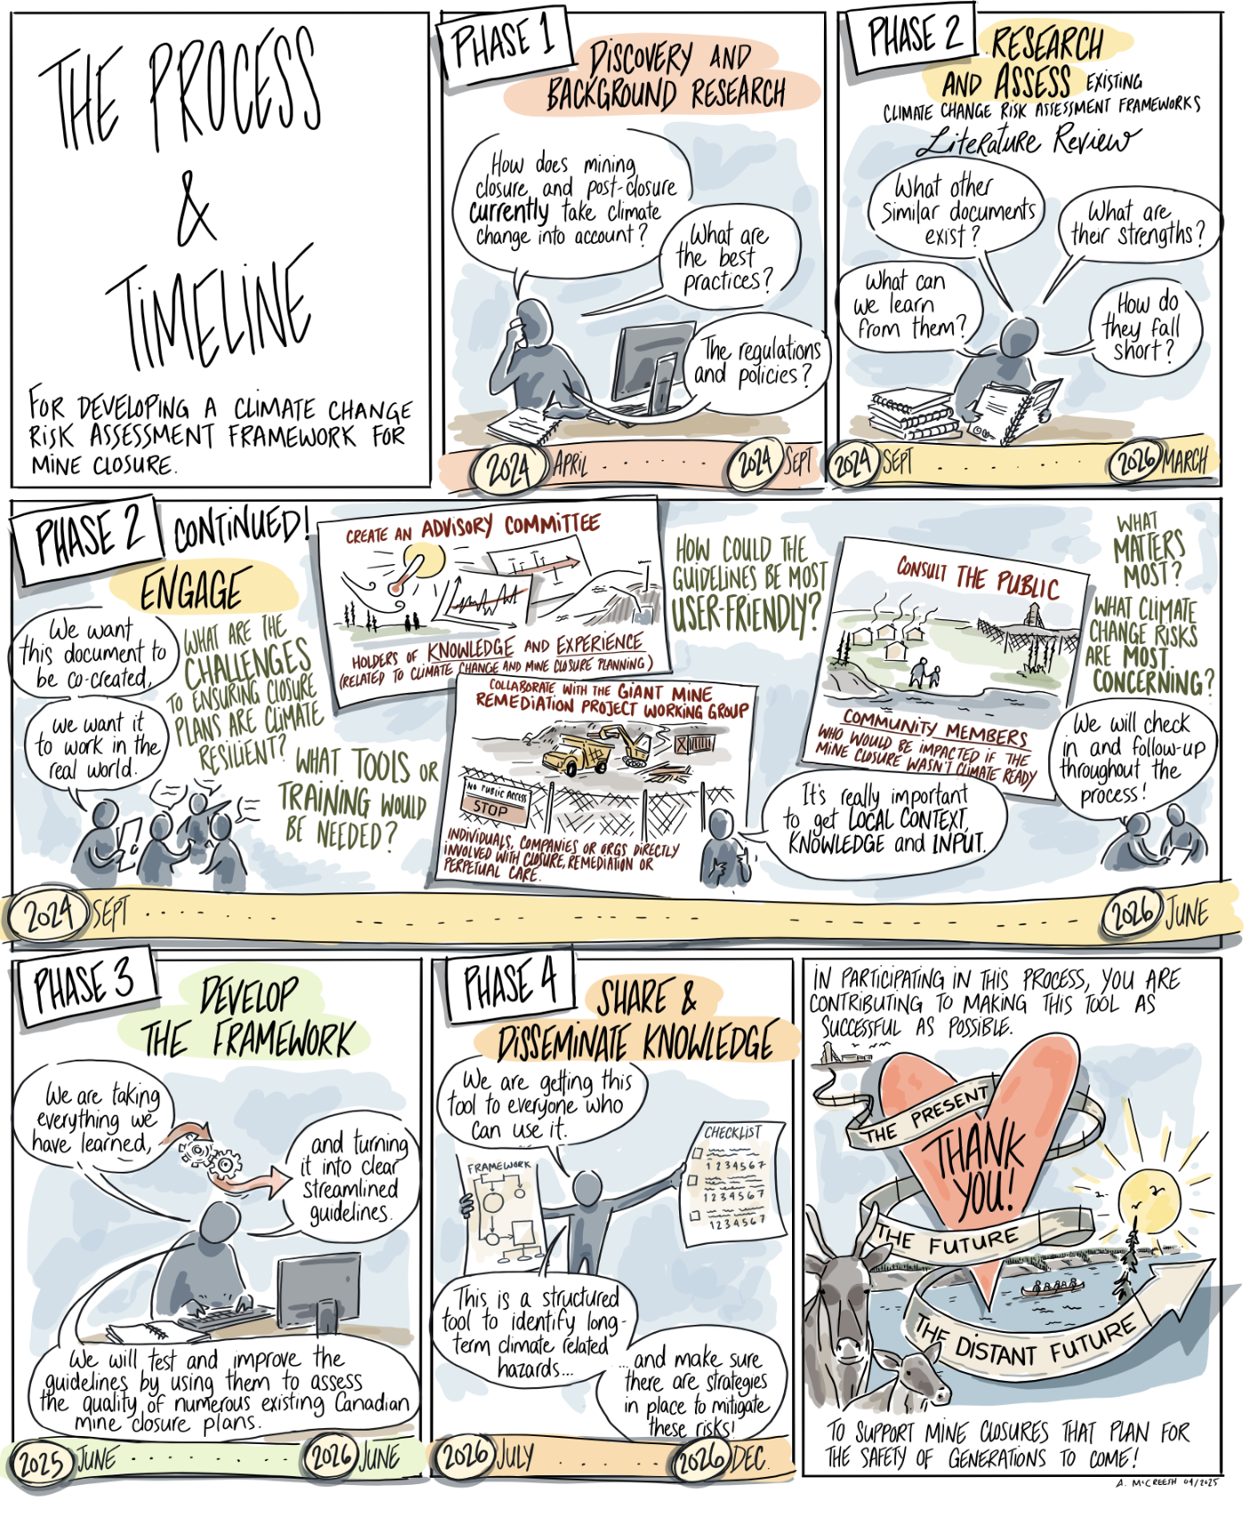
Project Timeline
Phase 1
Phase 2
Phase 3
Phase 4
April 2024 - Sep 2024
Project Planning & Background
Research
Visual narratives by Yellowknife artist Alison McCreesh
Notes:
Speaker: Aarisha

Slide 9
Project Timeline
Phase 1
Phase 2
Phase 3
Phase 4
April 2024 - Sep 2024
Sep 2024 - March 2026
Project Planning & Background
Research
Research,
Engagement & Framework Review
Visual narratives by Yellowknife artist Alison McCreesh
Notes:
Speaker: Aarisha

Slide 10
Project Timeline
Phase 1
Phase 2
Phase 3
Phase 4
April 2024 - Sep 2024
Sep 2024 - March 2026
Jun 2025 - Jun 2026
Project Planning & Background
Research
Research,
Engagement & Framework Review
Develop
Tools & Resources (Assessment Tool)
Visual narratives by Yellowknife artist Alison McCreesh
Notes:
Speaker: Aarisha

Slide 11
Project Timeline
Phase 1
Phase 2
Phase 3
Phase 4
April 2024 - Sep 2024
Sep 2024 - March 2026
Jun 2025 - Jun 2026
Jun 2026 - Dec 2026
Project Planning & Background
Research
Research,
Engagement & Framework Review
Develop
Tools & Resources (Assessment Tool)
Share & Disseminate Knowledge
Visual narratives by Yellowknife artist Alison McCreesh
Notes:
Speaker: Aarisha

Slide 12
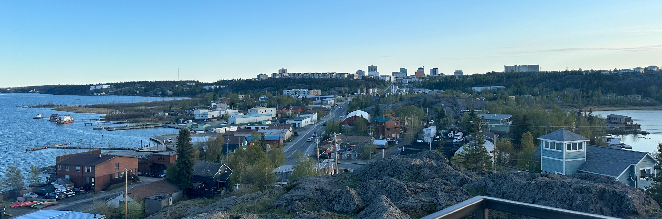
Initial Research & Engagement
Notes:
Speaker: Nic
Opening remarks / introduce research approach
Our project is meant to build on the work already being done to incorporate climate change into site closure and post closure - with the hope of creating something useful for the GM site and beyond
Climate adaptation practices in industry are falling behind because there are no clear guidelines
This project aims to fill that gap and to support industry practitioners such as yourself on this work
It is not a Giant Mine issue but a larger issue. Giant Mine is a case study we are using as it is a first remediation site to develop a PCP - and we think it is timely to be contributing anything we learn from the national level research to provide insight to the GMRP as test to see if the tool we are developing works
We are not coming from a place of regulatory guidelines but more so on the design of an assessment tool that will later be tested using Giant Mine and other contaminated sites
We recognize that GMRP is following industry practices and guidelines - and also that best practice is changing in relation to climate change and we don’t know a lot about it - it may be that industry practices are falling behind on climate action.
For the purpose of this project, we are only focusing on the design of the tool and we would like to collaborate with you to fill in the gap and the barriers you may be facing in your work
We are aiming to create the tool that would be an assessment tool for companies and agencies to see where they are at on their corporate social responsibility that impacts both society and environment.

Slide 13
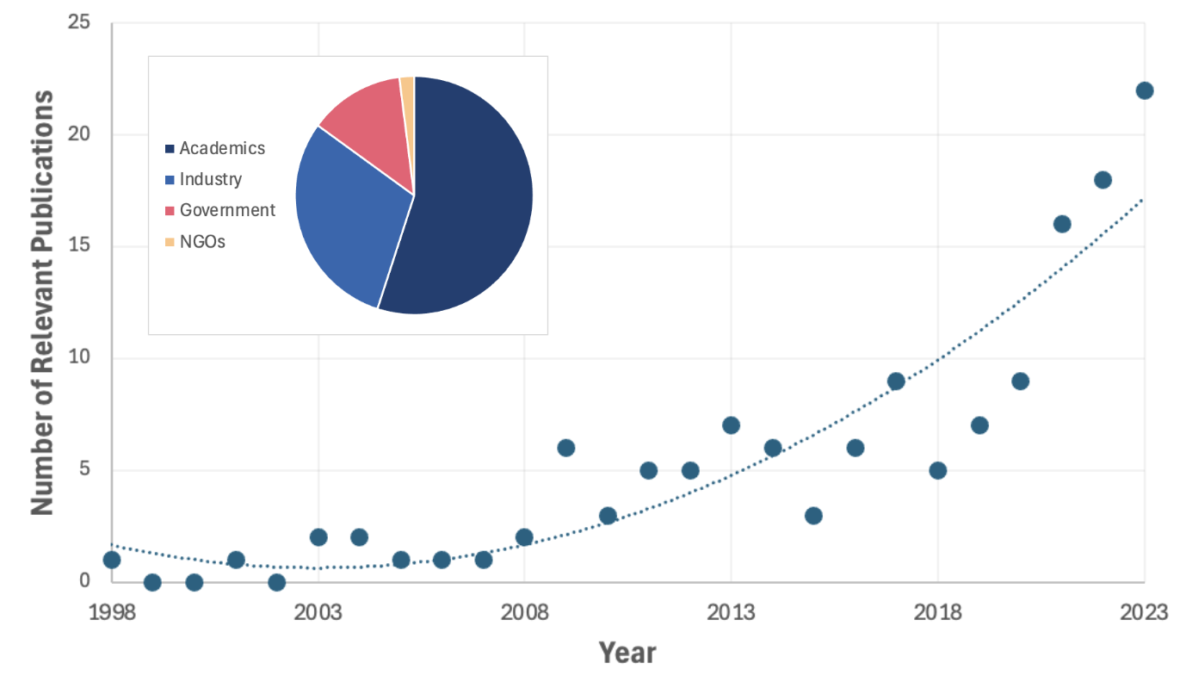
State of Climate Action in Canada
Systematic Literature Review of Mining-Based Publications
Systematic review of 150+ publications
Current state of knowledge on climate adaptation is relatively new.
Notes:
Speaker: numbers were used in Scoping review
We understand that mining is a major component of the global economy, and will continue to represent a prominent industry as the international community increases its demand for raw materials, and pursues critical mineral deposits to support the vision of a net-zero future. However, mine operations can have a complicated relationship with the environment, and can leave behind liabilities, such as eroded slopes and altered water bodies, whose potential impacts may be influenced by changes in environmental conditions.
Therefore, as we mentioned, this project aims to work towards the development of a planning and assessment tool to support industry professionals across the country in developing “climate-ready” mine closure and post-closure plans. In order to do so, the first step was for our team to characterize the current state of knowledge and action related to climate adaptation practices in the post-closure phase of mining in Canada.
As of November 2024, our preliminary analysis has shown us that Canadian attention to climate adaptation and perpetual care of mining sites is relatively new, with dialogue related to this topic increasing substantially in the last 5-6 years. In terms of authorship, we found that academics and industry professionals were responsible for around 85% of publications discussing this issue, with a notably small amount of guidance coming from federal, provincial, or municipal levels of government. Correspondingly, many of the barriers to implementing adaptation measures in this phase of mining were found to revolve around a lack of clear guidance.

Slide 14
State of Climate Action in Canada
Systematic Literature Review of Mining-Based Publications
Systematic review of 150+ publications
Current state of knowledge on climate adaptation is relatively new.
Dominant voices are academics and industry professionals.
Notes:
Speaker: numbers were used in Scoping review
We understand that mining is a major component of the global economy, and will continue to represent a prominent industry as the international community increases its demand for raw materials, and pursues critical mineral deposits to support the vision of a net-zero future. However, mine operations can have a complicated relationship with the environment, and can leave behind liabilities, such as eroded slopes and altered water bodies, whose potential impacts may be influenced by changes in environmental conditions.
Therefore, as we mentioned, this project aims to work towards the development of a planning and assessment tool to support industry professionals across the country in developing “climate-ready” mine closure and post-closure plans. In order to do so, the first step was for our team to characterize the current state of knowledge and action related to climate adaptation practices in the post-closure phase of mining in Canada.
As of November 2024, our preliminary analysis has shown us that Canadian attention to climate adaptation and perpetual care of mining sites is relatively new, with dialogue related to this topic increasing substantially in the last 5-6 years. In terms of authorship, we found that academics and industry professionals were responsible for around 85% of publications discussing this issue, with a notably small amount of guidance coming from federal, provincial, or municipal levels of government. Correspondingly, many of the barriers to implementing adaptation measures in this phase of mining were found to revolve around a lack of clear guidance.

Slide 15
State of Climate Action in Canada
Systematic Literature Review of Mining-Based Publications
Systematic review of 150+ publications
Current state of knowledge on climate adaptation is relatively new.
Dominant voices are academics and industry professionals.
Adaptation practices in industry are falling behind due to lack of guidance.
Notes:
Speaker: numbers were used in Scoping review
We understand that mining is a major component of the global economy, and will continue to represent a prominent industry as the international community increases its demand for raw materials, and pursues critical mineral deposits to support the vision of a net-zero future. However, mine operations can have a complicated relationship with the environment, and can leave behind liabilities, such as eroded slopes and altered water bodies, whose potential impacts may be influenced by changes in environmental conditions.
Therefore, as we mentioned, this project aims to work towards the development of a planning and assessment tool to support industry professionals across the country in developing “climate-ready” mine closure and post-closure plans. In order to do so, the first step was for our team to characterize the current state of knowledge and action related to climate adaptation practices in the post-closure phase of mining in Canada.
As of November 2024, our preliminary analysis has shown us that Canadian attention to climate adaptation and perpetual care of mining sites is relatively new, with dialogue related to this topic increasing substantially in the last 5-6 years. In terms of authorship, we found that academics and industry professionals were responsible for around 85% of publications discussing this issue, with a notably small amount of guidance coming from federal, provincial, or municipal levels of government. Correspondingly, many of the barriers to implementing adaptation measures in this phase of mining were found to revolve around a lack of clear guidance.

Slide 16
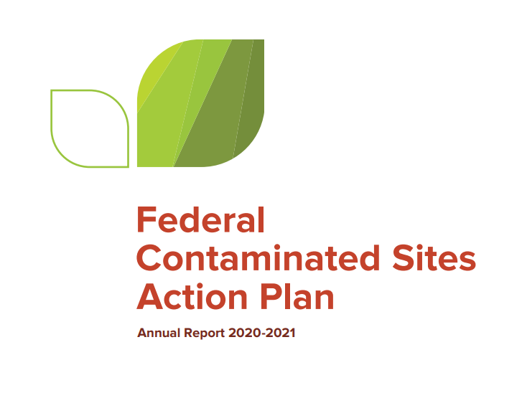



State of Climate Action in Canada
Systematic Literature Review of Mining-Based Publications
Systematic review of 150+ publications
Most climate change risk assessment frameworks / resources relevant to resource sector released and/or updated in the last 3-5 years.
The sector could benefit from clear guidance and user-friendly tools and resources to effectively incorporate a long-term climate lens into closure & perpetual care planning.
Notes:
Speaker: Trennon
We understand that mining is a major component of the global economy, and will continue to represent a prominent industry as the international community increases its demand for raw materials, and pursues critical mineral deposits to support the vision of a net-zero future. However, mine operations can have a complicated relationship with the environment, and can leave behind liabilities, such as eroded slopes and altered water bodies, whose potential impacts may be influenced by changes in environmental conditions.
Therefore, as we mentioned, this project aims to work towards the development of a planning and assessment tool to support industry professionals across the country in developing “climate-ready” mine closure and post-closure plans. In order to do so, the first step was for our team to characterize the current state of knowledge and action related to climate adaptation practices in the post-closure phase of mining in Canada.
As of November 2024, our preliminary analysis has shown us that Canadian attention to climate adaptation and perpetual care of mining sites is relatively new, with dialogue related to this topic increasing substantially in the last 5-6 years. In terms of authorship, we found that academics and industry professionals were responsible for around 85% of publications discussing this issue, with a notably small amount of guidance coming from federal, provincial, or municipal levels of government. Correspondingly, many of the barriers to implementing adaptation measures in this phase of mining were found to revolve around a lack of clear guidance.

Slide 17
State of Climate Action in Canada
Systematic Literature Review of Mining-Based Publications
Systematic review of 150+ publications
Most climate change risk assessment frameworks / resources relevant to resource sector released and/or updated in the last 3-5 years.
Few of these frameworks are relevant or tailored to the mining sector.
The sector could benefit from clear guidance and user-friendly tools and resources to effectively incorporate a long-term climate lens into closure & perpetual care planning.
Notes:
Speaker: Trennon
We understand that mining is a major component of the global economy, and will continue to represent a prominent industry as the international community increases its demand for raw materials, and pursues critical mineral deposits to support the vision of a net-zero future. However, mine operations can have a complicated relationship with the environment, and can leave behind liabilities, such as eroded slopes and altered water bodies, whose potential impacts may be influenced by changes in environmental conditions.
Therefore, as we mentioned, this project aims to work towards the development of a planning and assessment tool to support industry professionals across the country in developing “climate-ready” mine closure and post-closure plans. In order to do so, the first step was for our team to characterize the current state of knowledge and action related to climate adaptation practices in the post-closure phase of mining in Canada.
As of November 2024, our preliminary analysis has shown us that Canadian attention to climate adaptation and perpetual care of mining sites is relatively new, with dialogue related to this topic increasing substantially in the last 5-6 years. In terms of authorship, we found that academics and industry professionals were responsible for around 85% of publications discussing this issue, with a notably small amount of guidance coming from federal, provincial, or municipal levels of government. Correspondingly, many of the barriers to implementing adaptation measures in this phase of mining were found to revolve around a lack of clear guidance.

Slide 18
State of Climate Action in Canada
Systematic Literature Review of Mining-Based Publications
Systematic review of 150+ publications
Most climate change risk assessment frameworks / resources relevant to resource sector released and/or updated in the last 3-5 years.
Few of these frameworks are relevant or tailored to the mining sector.
Lack of comprehensive process in implementing a climate risk assessment in post closure mining activities.
The sector could benefit from clear guidance and user-friendly tools and resources to effectively incorporate a long-term climate lens into closure & perpetual care planning.
Notes:
Speaker: Trennon
We understand that mining is a major component of the global economy, and will continue to represent a prominent industry as the international community increases its demand for raw materials, and pursues critical mineral deposits to support the vision of a net-zero future. However, mine operations can have a complicated relationship with the environment, and can leave behind liabilities, such as eroded slopes and altered water bodies, whose potential impacts may be influenced by changes in environmental conditions.
Therefore, as we mentioned, this project aims to work towards the development of a planning and assessment tool to support industry professionals across the country in developing “climate-ready” mine closure and post-closure plans. In order to do so, the first step was for our team to characterize the current state of knowledge and action related to climate adaptation practices in the post-closure phase of mining in Canada.
As of November 2024, our preliminary analysis has shown us that Canadian attention to climate adaptation and perpetual care of mining sites is relatively new, with dialogue related to this topic increasing substantially in the last 5-6 years. In terms of authorship, we found that academics and industry professionals were responsible for around 85% of publications discussing this issue, with a notably small amount of guidance coming from federal, provincial, or municipal levels of government. Correspondingly, many of the barriers to implementing adaptation measures in this phase of mining were found to revolve around a lack of clear guidance.

Slide 19
State of Climate Action in Canada
Systematic Literature Review of Mining-Based Publications
Systematic review of 150+ publications
Most climate change risk assessment frameworks / resources relevant to resource sector released and/or updated in the last 3-5 years.
Few of these frameworks are relevant or tailored to the mining sector.
Lack of comprehensive process in implementing a climate risk assessment in post closure mining activities.
Engagement & discussions with 15 industry experts confirmed gap in availability of a clear or comprehensive framework.
The sector could benefit from clear guidance and user-friendly tools and resources to effectively incorporate a long-term climate lens into closure & perpetual care planning.
Notes:
Speaker: Trennon
We understand that mining is a major component of the global economy, and will continue to represent a prominent industry as the international community increases its demand for raw materials, and pursues critical mineral deposits to support the vision of a net-zero future. However, mine operations can have a complicated relationship with the environment, and can leave behind liabilities, such as eroded slopes and altered water bodies, whose potential impacts may be influenced by changes in environmental conditions.
Therefore, as we mentioned, this project aims to work towards the development of a planning and assessment tool to support industry professionals across the country in developing “climate-ready” mine closure and post-closure plans. In order to do so, the first step was for our team to characterize the current state of knowledge and action related to climate adaptation practices in the post-closure phase of mining in Canada.
As of November 2024, our preliminary analysis has shown us that Canadian attention to climate adaptation and perpetual care of mining sites is relatively new, with dialogue related to this topic increasing substantially in the last 5-6 years. In terms of authorship, we found that academics and industry professionals were responsible for around 85% of publications discussing this issue, with a notably small amount of guidance coming from federal, provincial, or municipal levels of government. Correspondingly, many of the barriers to implementing adaptation measures in this phase of mining were found to revolve around a lack of clear guidance.

Slide 20
NWT Engagement Highlights
Youth
St Patricks Highschool
Dechinta
Indigenous Land Based Education
Community
Farmers Market
Community
Engagement Event
Regulatory
Stakeholder Engagement
Notes:
Speaker:

Slide 21
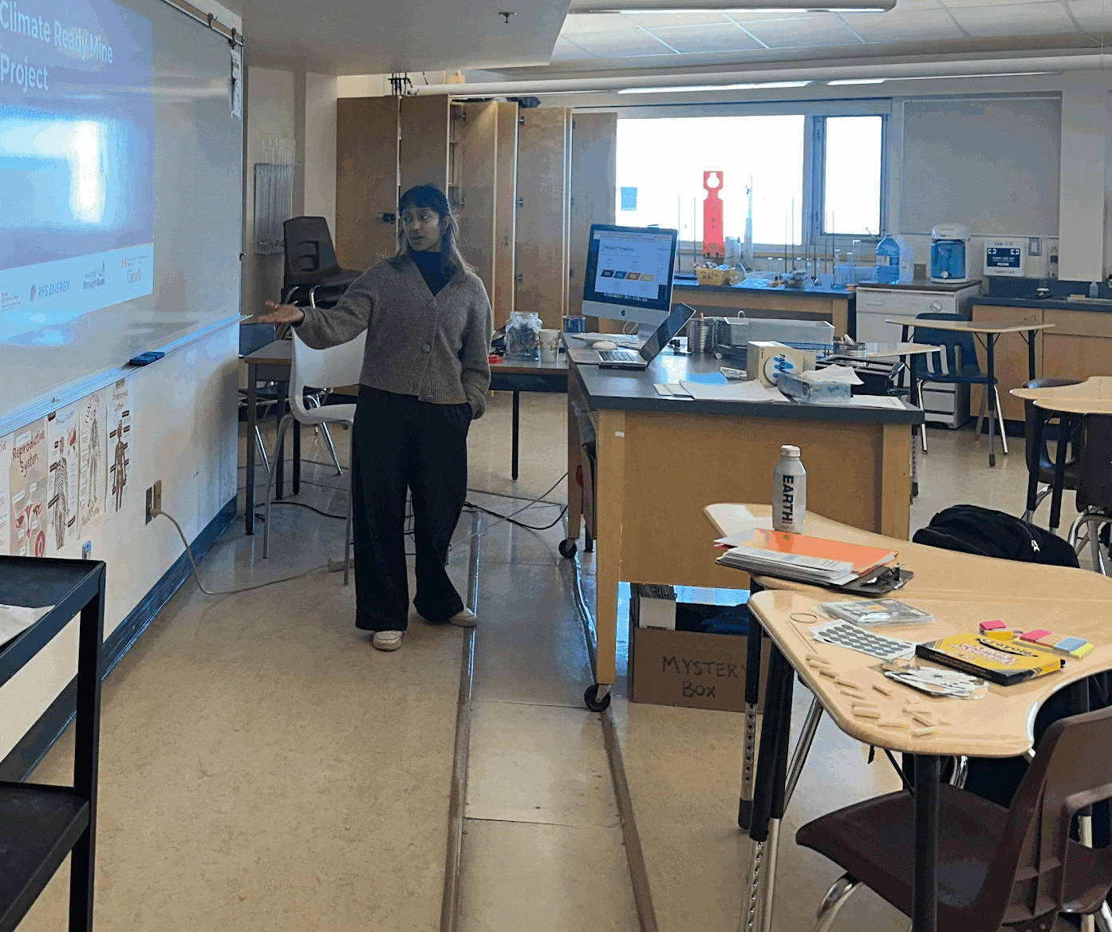
NWT Engagement Highlights
Youth
St Patricks Highschool
Dechinta
Indigenous Land Based Education
Community
Farmers Market
Community
Engagement Event
Regulatory
Stakeholder Engagement
Presentation on project themes | Participatory mapping and discussion of local climate impacts
Notes:
Speaker:

Slide 22
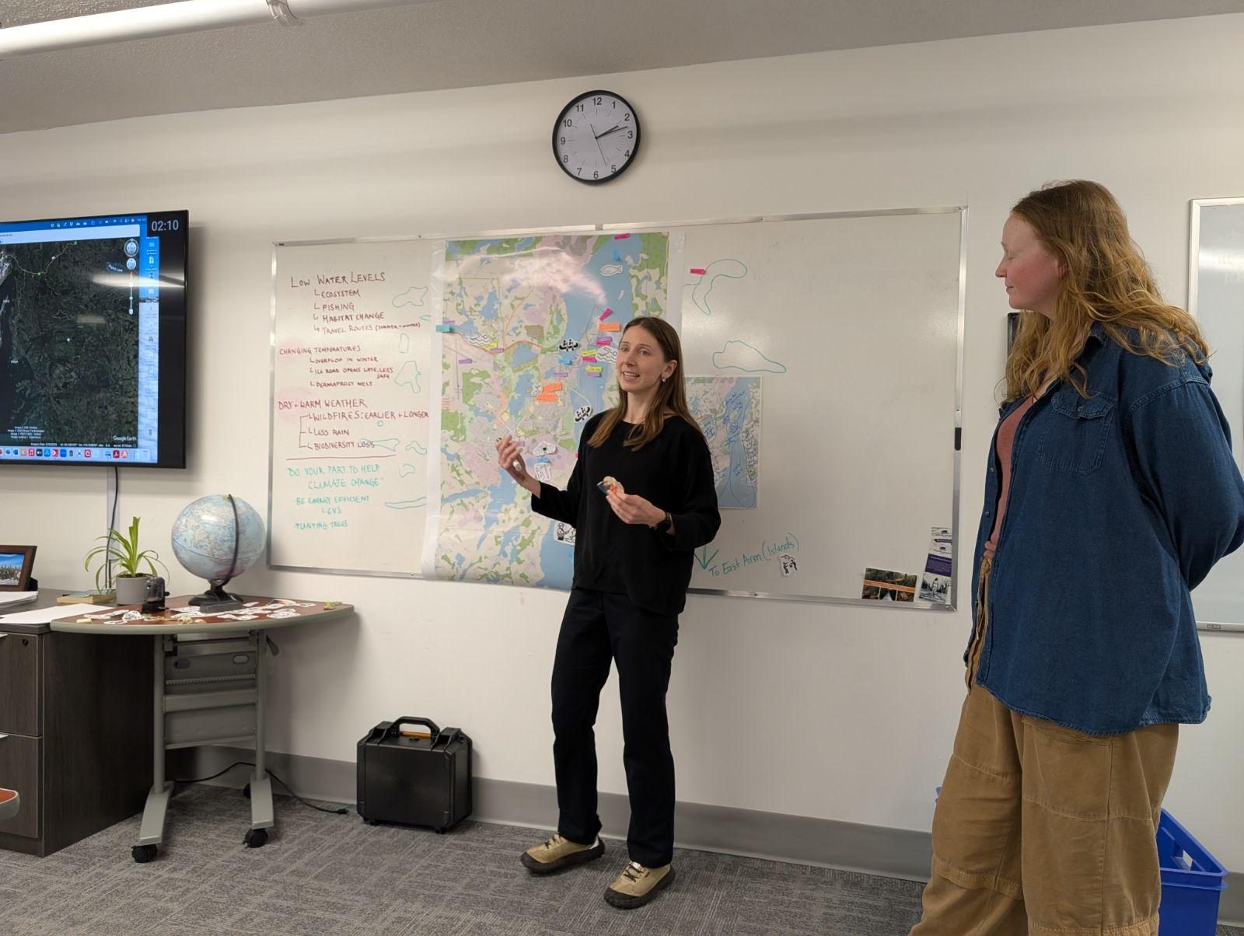
NWT Engagement Highlights
Youth
St Patricks Highschool
Dechinta
Indigenous Land Based Education
Community
Farmers Market
Community
Engagement Event
Regulatory
Stakeholder Engagement
Presentation on project themes | Participatory mapping and discussion of local climate impacts
Emphasis on Indigenous knowledge and leadership in ecosystem monitoring and assessment | Excitement and mistrust of government initiatives
Notes:
Speaker:

Slide 23
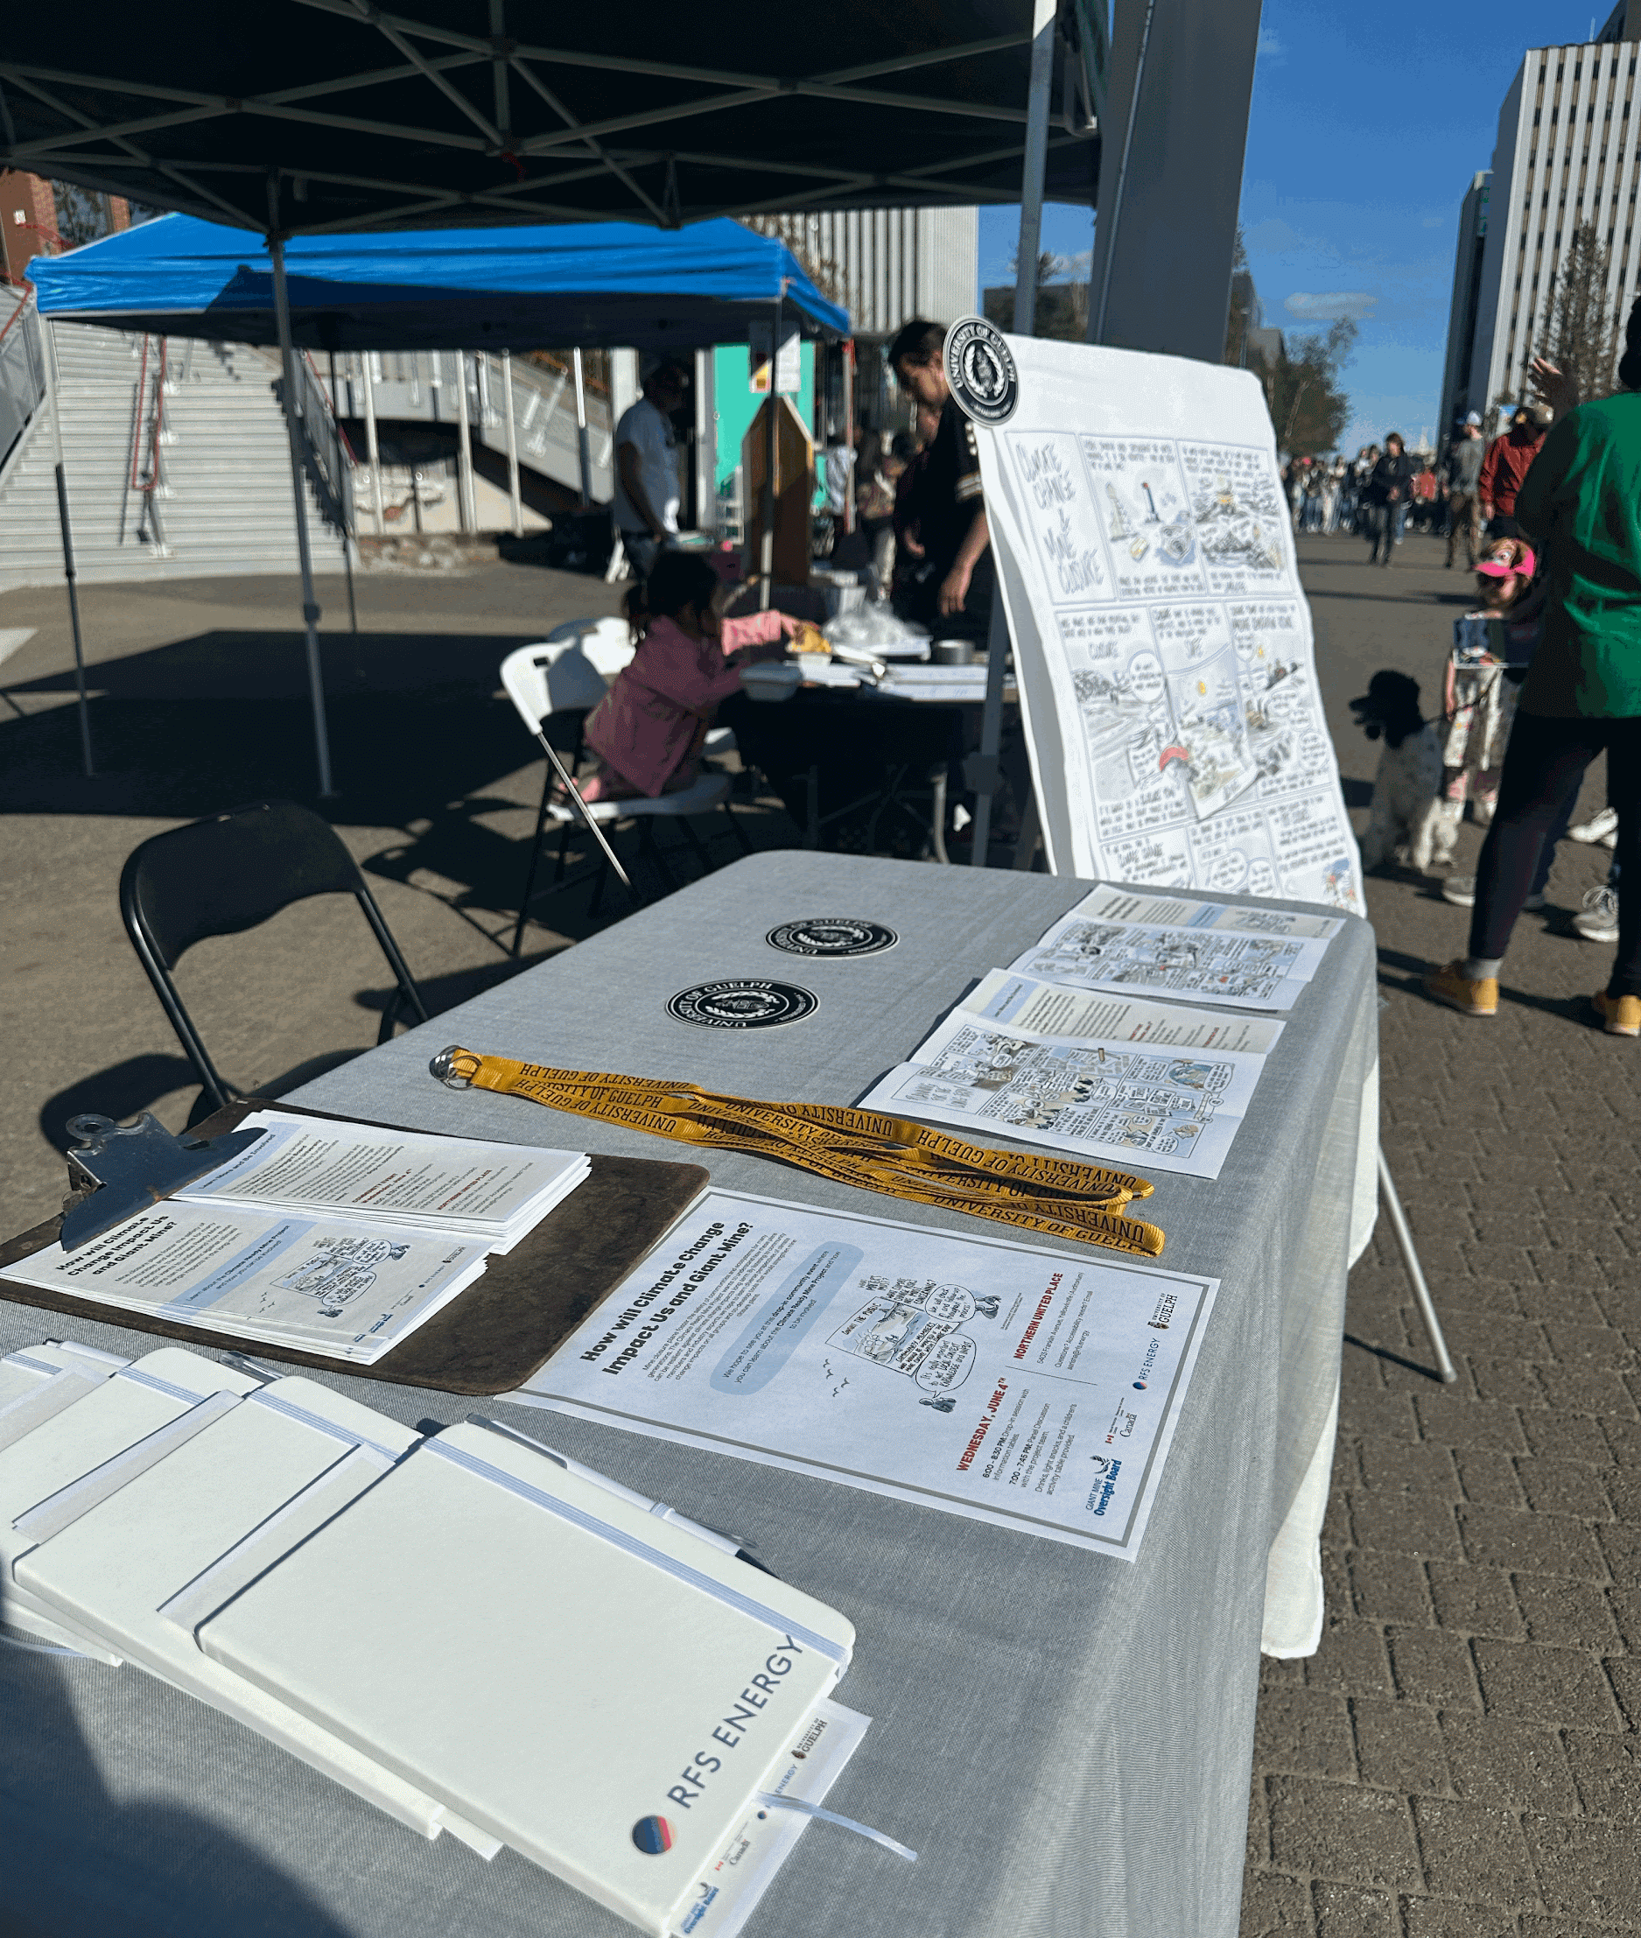
NWT Engagement Highlights
Youth
St Patricks Highschool
Dechinta
Indigenous Land Based Education
Community
Farmers Market
Community
Engagement Event
Regulatory
Stakeholder Engagement
Presentation on project themes | Participatory mapping and discussion of local climate impacts
Emphasis on Indigenous knowledge and leadership in ecosystem monitoring and assessment | Excitement and mistrust of government initiatives
Project information table and comic materials by Alison McCreesh | Promotion helped boost community event attendance
Notes:
Speaker:

Slide 24
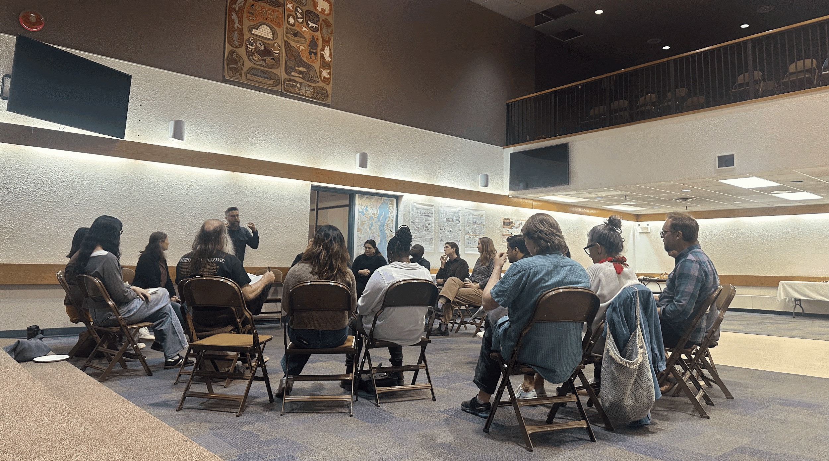
NWT Engagement Highlights
Youth
St Patricks Highschool
Dechinta
Indigenous Land Based Education
Community
Farmers Market
Community
Engagement Event
Regulatory
Stakeholder Engagement
Presentation on project themes | Participatory mapping and discussion of local climate impacts
Emphasis on Indigenous knowledge and leadership in ecosystem monitoring and assessment | Excitement and mistrust of government initiatives
Project information table and comic materials by Alison McCreesh | Promotion helped boost community event attendance
Drop-in information & feedback session with ~20 attendees | Local orgs hosted tables, CBC Yellowknife covered event
Notes:
Speaker:

Slide 25
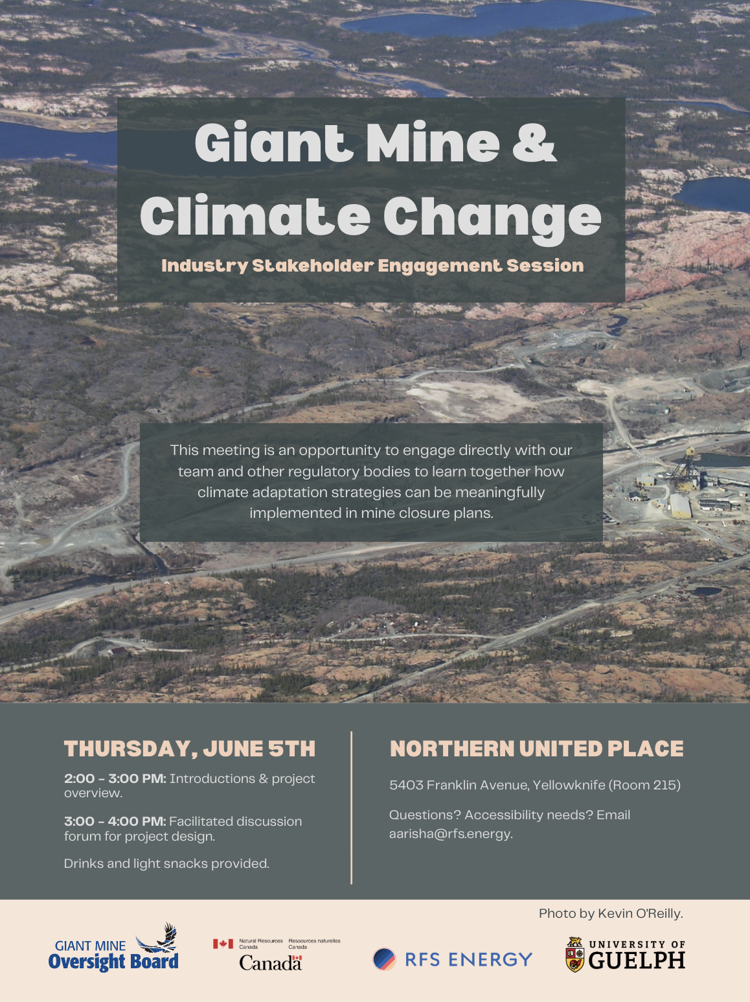
NWT Engagement Highlights
Youth
St Patricks Highschool
Dechinta
Indigenous Land Based Education
Community
Farmers Market
Community
Engagement Event
Regulatory
Stakeholder Engagement
Presentation on project themes | Participatory mapping and discussion of local climate impacts
Emphasis on Indigenous knowledge and leadership in ecosystem monitoring and assessment | Excitement and mistrust of government initiatives
Project information table and comic materials by Alison McCreesh | Promotion helped boost community event attendance
Drop-in information & feedback session with ~20 attendees | Local orgs hosted tables, CBC Yellowknife covered event
Engagement session with ~10 regulatory professionals and stakeholders
Notes:
Speaker:

Slide 26
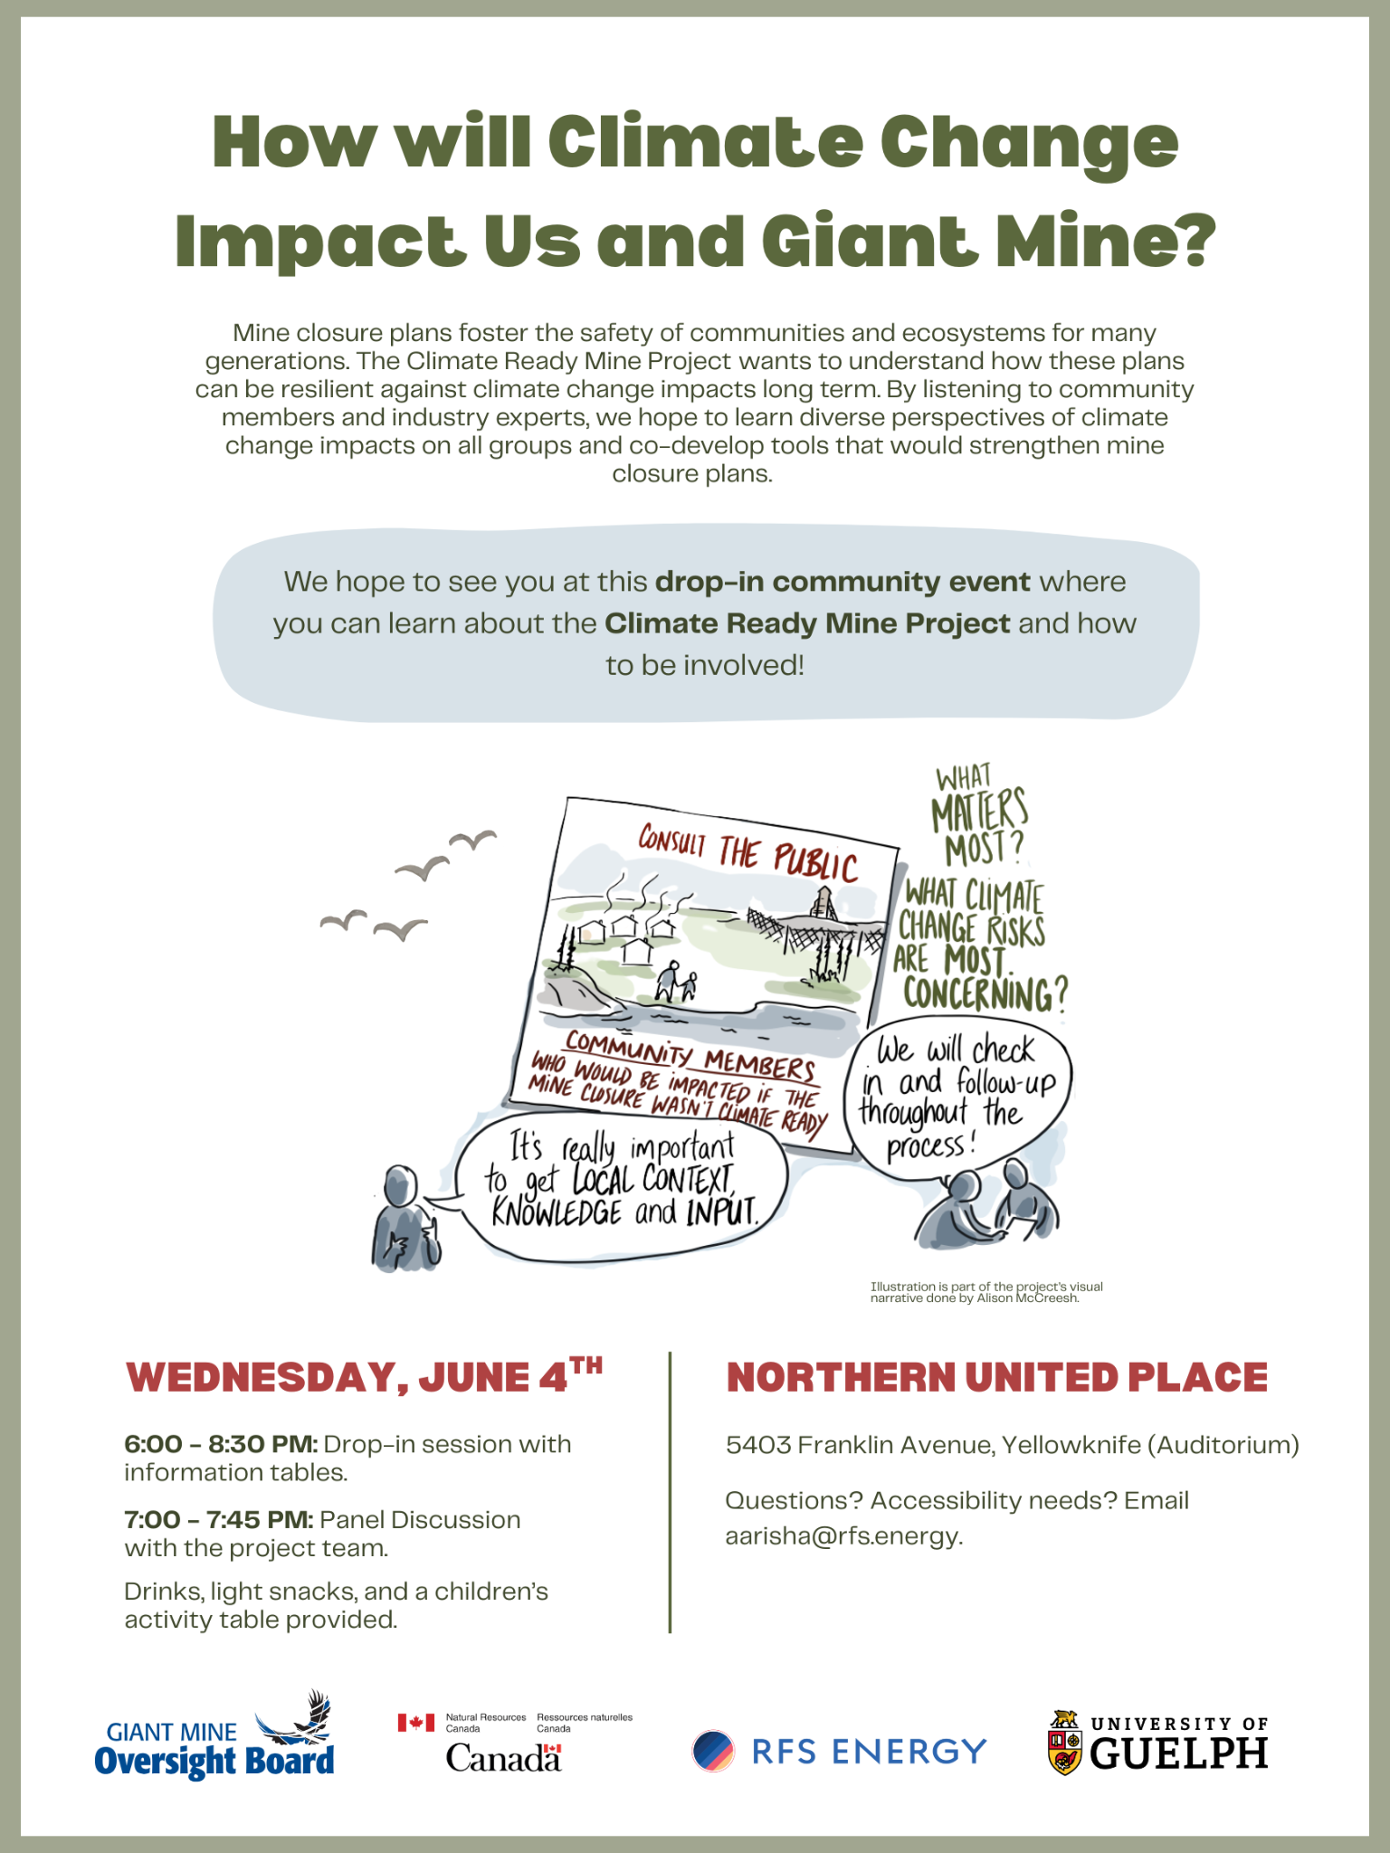
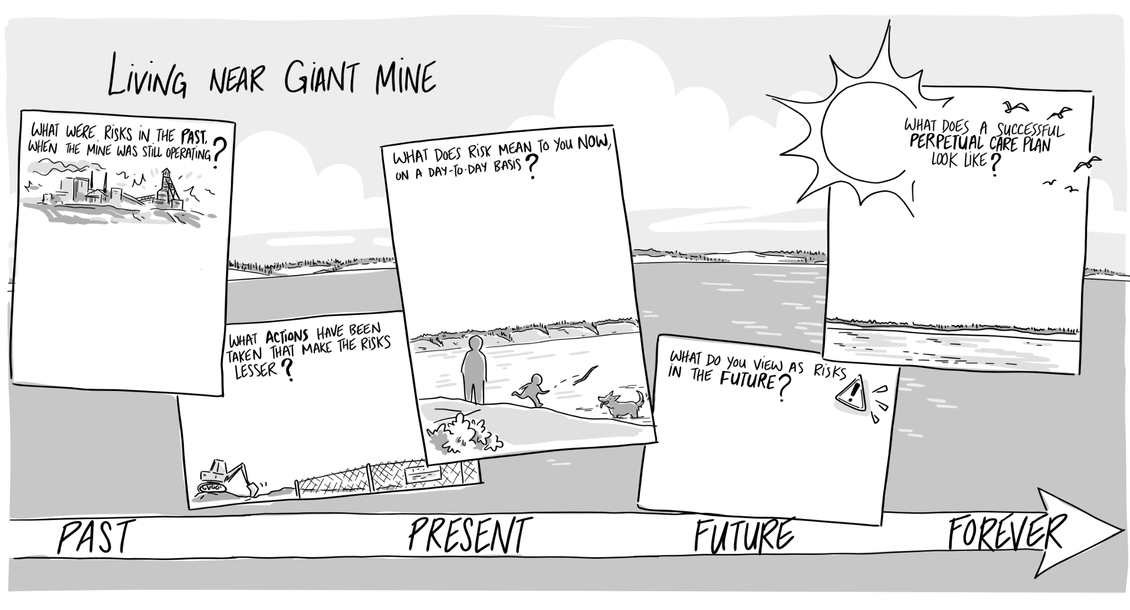
NWT Engagement Highlights
Visual narratives by Yellowknife artist Alison McCreesh
Notes:
Speaker:

Slide 27
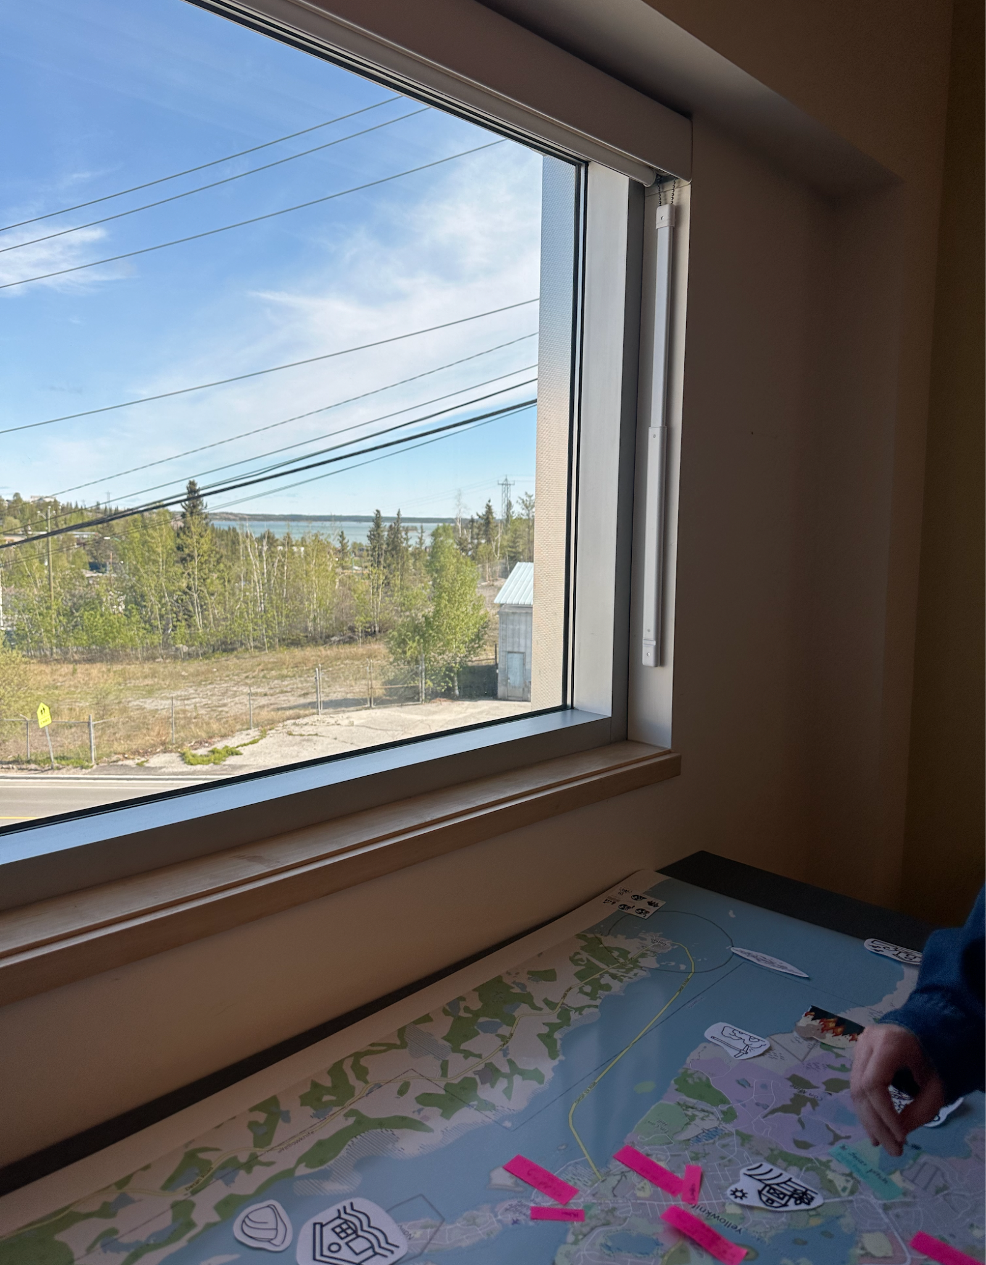
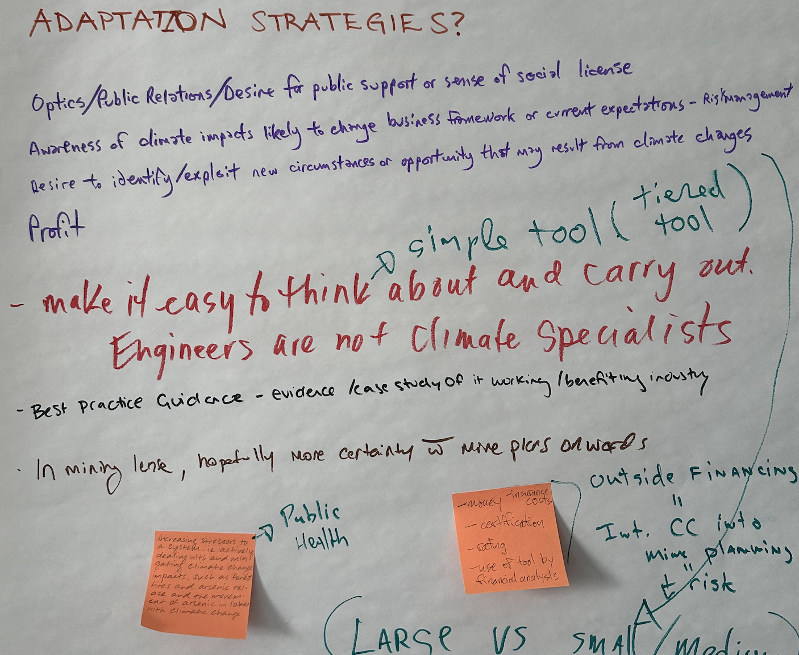
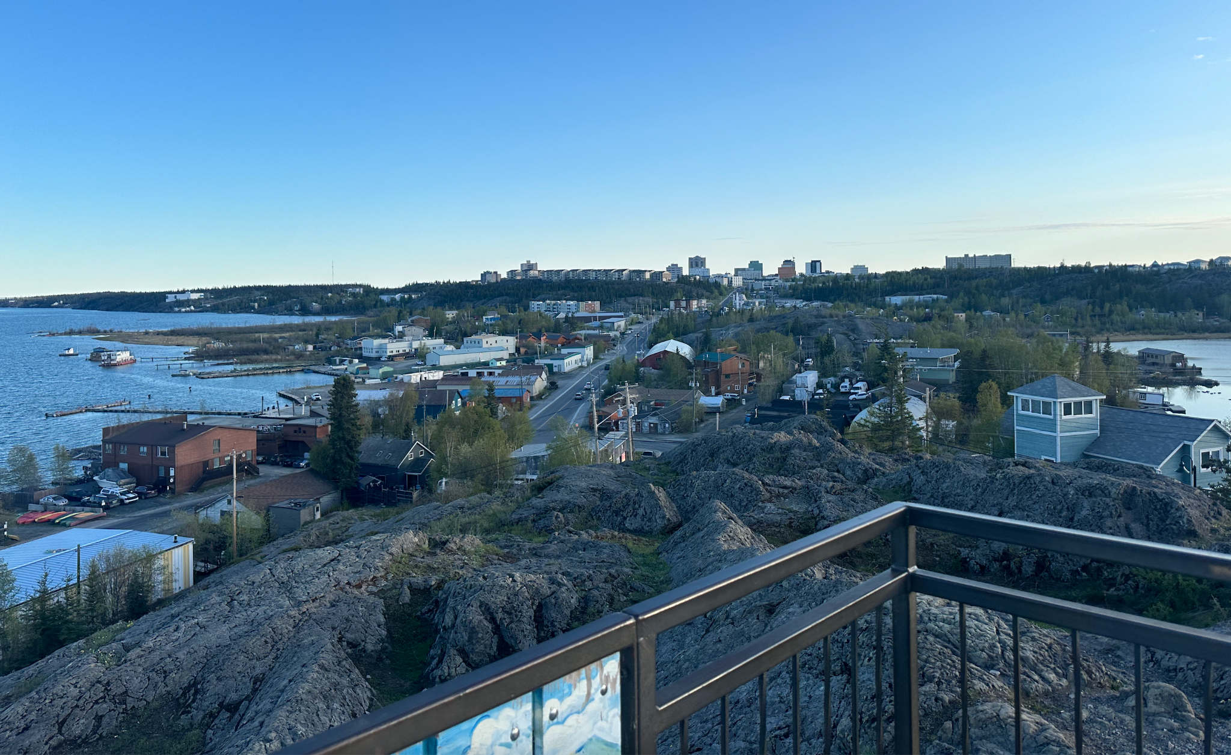
NWT Engagement Highlights
What We Learned
Key Message: Avoid focusing communications on Giant Mine, look for applicability for other closure plans
Notes:
Speaker:

Slide 28
NWT Engagement Highlights
What We Learned
Key Message: Avoid focusing communications on Giant Mine, look for applicability for other closure plans
Regulatory
What incentivizes adaptation?
Public relations, risk management, profit, insurance
Simplicity of tools, guidance, and certifications
Public health and environmental stressors
Needed Resources:
Frameworks, templates, checklists
Clear links between climate change and mine planning
Notes:
Speaker:

Slide 29
NWT Engagement Highlights
What We Learned
Key Message: Avoid focusing communications on Giant Mine, look for applicability for other closure plans
Regulatory
What incentivizes adaptation?
Public relations, risk management, profit, insurance
Simplicity of tools, guidance, and certifications
Public health and environmental stressors
Needed Resources:
Frameworks, templates, checklists
Clear links between climate change and mine planning
Community
Key interest in climate change adaptation and nearby mines
Emphasize the national scope to maintain neutrality
Interest from youth and Dechinta Training Centre to learn and be involved
Notes:
Speaker:

Slide 30
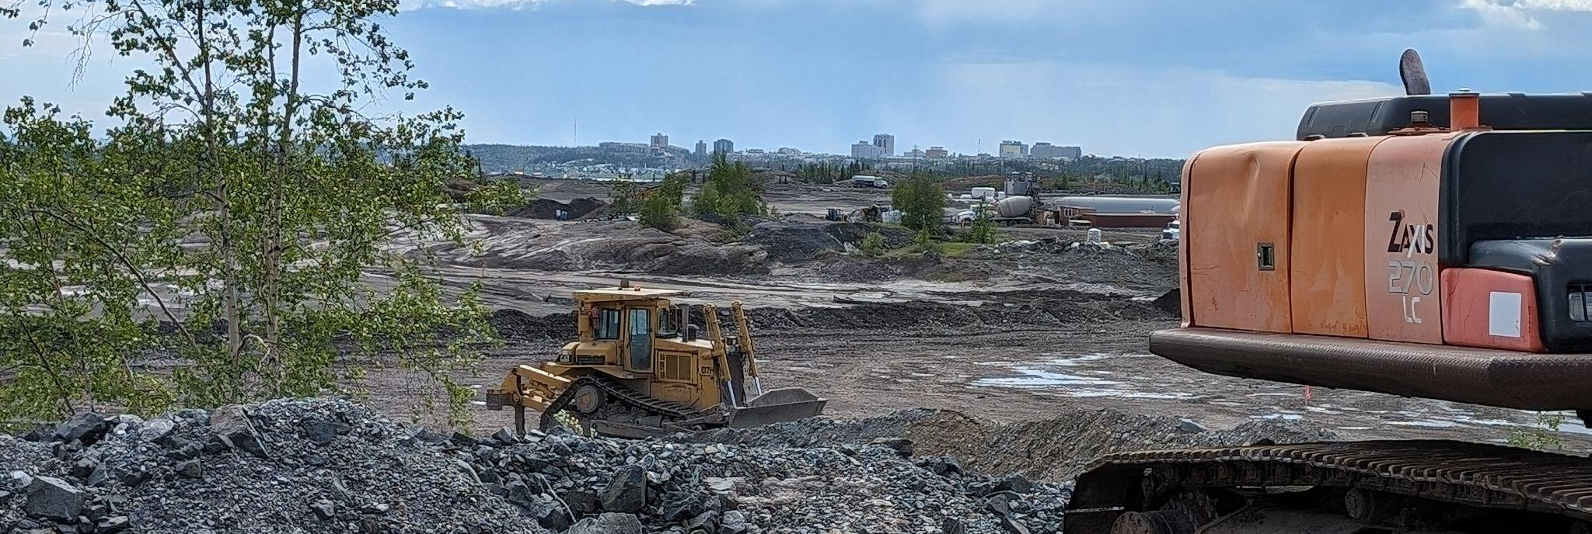
Q&A and Discussion
Notes:
Speaker: Trennon
With that, I think that concludes the formal component of our presentation. We want to thank you all for your time and participation today, and open up the rest of the meeting for questions and discussions.

Slide 31
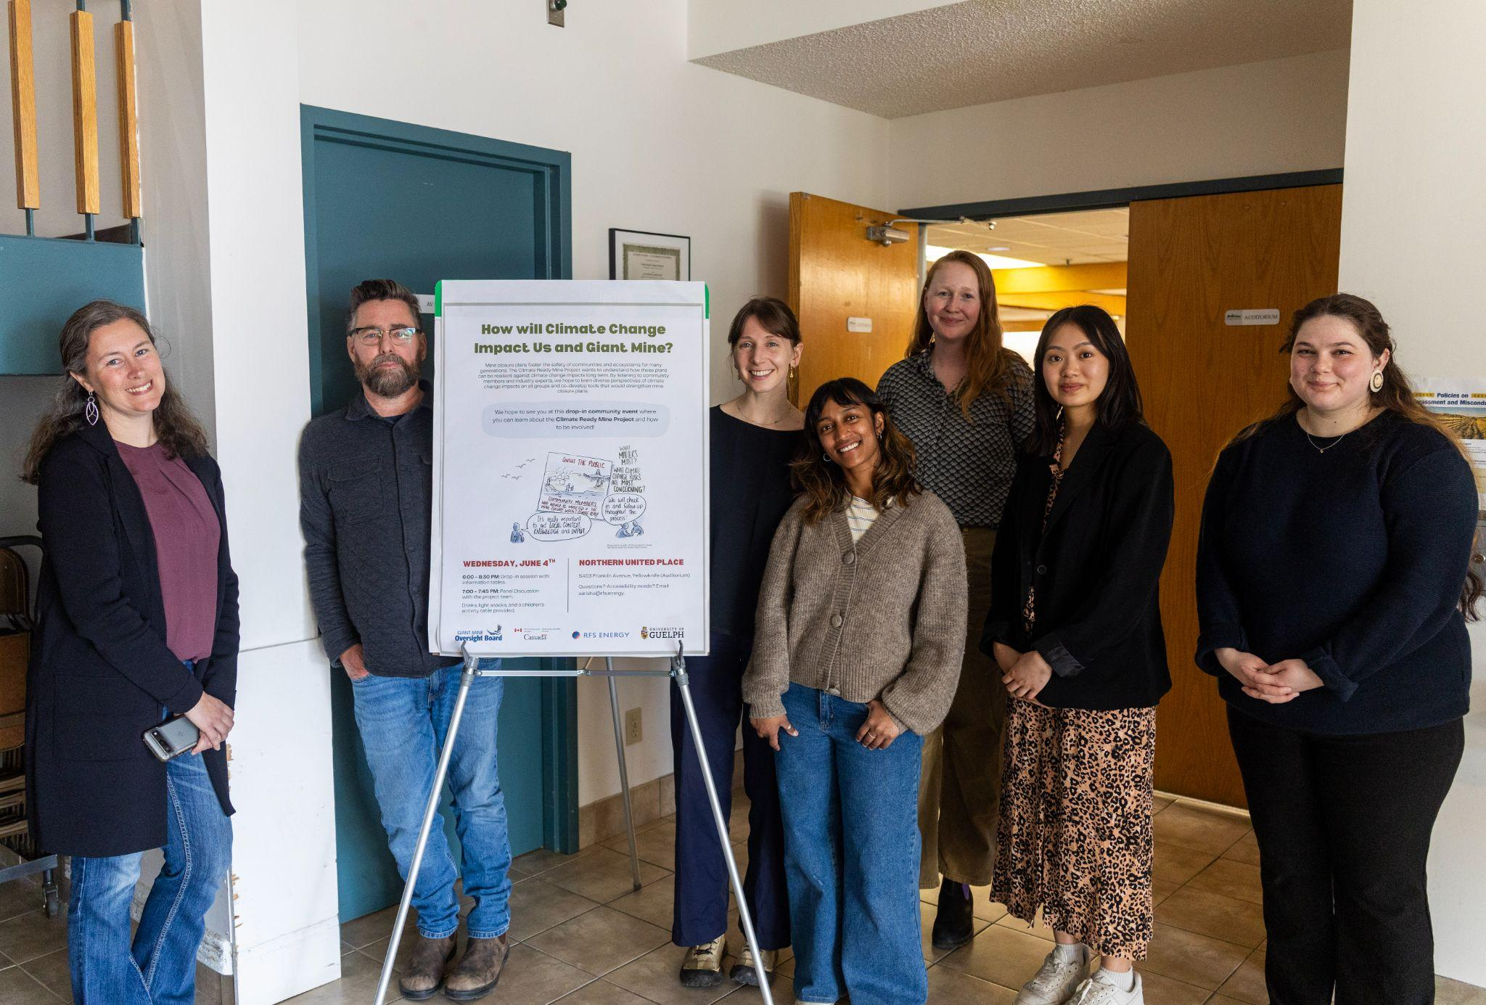
Thank You!
For more information, please contact:
Aarisha Haider
Project Manager
aarisha@rfs.energy

